Slide 1
Biomedical Modeling: Introduction to the Agent-based epidemic modeling
Dr. Qi Mi
Department of Sports Medicine and Nutrition, SHRS, Univ. of Pitt

Slide 2
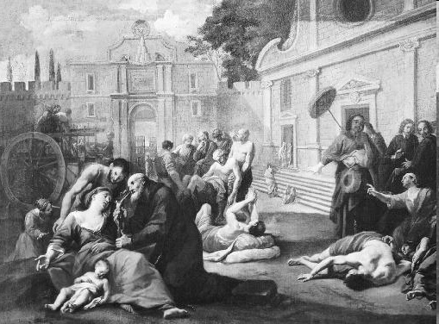
Why An Epidemic Model?
The study of how disease is distributed in populations and the factors that influence or determine this distribution
Epidemics have been responsible for great losses of life and have acted as a population control (Black Plague, Spanish Influenza)and are still a cause of concern today and in the future (SARS, H1N1 Swine Flu)
The study is important in understanding and preventing the spread of disease throughout a population.
http://www.solarnavigator.net/animal_kingdom/animal_images/death_black_plague_street_scene.jpg
Notes:
Epidemiologists may conduct studies in order to find the cause and risk factors associated with a disease, discover the extent of a disease in the community, study the history and prognosis of the disease, evaluate healthcare methods already in place, or develop new public policy and regulations

Slide 3
Age, sex ,occupation or the immune status of the individual
Host
vector
Biological (bacteria, viruses), chemical (poisons), physical (trauma from radiation or fire)
Temperature, humidity, housing,
availability of food and water
Agent
Environment
Fig1. The epidemiologic triad of a disease
Notes:
The prevalence and extent of disease depends on many factors, which can be considered broadly as 3 categories: the characteristics of the host, the agent involved, and the environment. The interplay of these categories affects how a disease can spread within a given population, as illustrated in figure 1. As these factors interact to intensify or diminish the spread of a disease, it is important that they are studied in each case, in order to understand their role in the spread of a particular disease. An understanding of how these factors interact for a particular disease can lead to measures to control or prevent its spread. For example, epidemiologists may uncover that a particular disease is caused by a bacteria, leading to the use of antibiotics to try and control an outbreak. If the likelihood of being exposed to a disease is influenced by a person’s occupation, measures can be introduced to control this (such as requiring medical staff to be vaccinated against Hepatitis B, for example). Another example would be the use of flu vaccines only for those most at risk, such as the elderly and asthmatics, using fewer resources than vaccinating a whole population

Slide 4
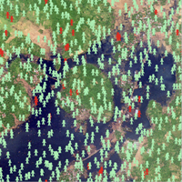
Why Agent-Based?
Originally tried System Dynamics
Agent-Based Modeling makes more sense
Individual behaviors differ and can greatly affect the course of an epidemic outbreak
A user can observe an individual agent over time
Good visual representation

Slide 5
Features of Agent-based Modeling (ABM)
Rule-based
Discrete-event/Discrete-time
Spatial
Parallelism
Stochastic
Ease to translate conceptual models to executable form
An, G., Mi, Q., Dutta-Moscato, J., Vodovotz, Y., Agent-based Models in translational systems biology, Wiley Interdisciplinary Reviews: System Biology and Medicine, 2009 Volume1, Issue 2: 159-171

Slide 6
Components of ABM
Turtle
Patch
Space

Slide 7
Two Samples
Wolf Sheep Predation
Tyhoid Fever on Disaster Area

Slide 8
ABM tool: NetLogo
NetLogo 4.1 (Developed at Northwestern)
User friendly programming environment and simple language (Logo like)
Cross-platform support
Windows, Linux, Mac
Depends on Java
Free!

Slide 9
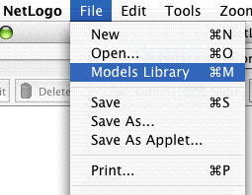
Tutorial 1: Sample model (Wolf Sheep Predation)

Slide 10
Press the "setup" button.
What do you see appear in the view?
Press the "go" button to start the simulation.
As the model is running, what is happening to the wolf and sheep populations?
Press the "go" button to stop the model.

Slide 11
Controlling the Model: Buttons
"forever" button
"once" button

Slide 12
Controlling speed: Speed Slider

Slide 13
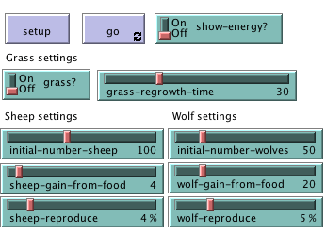
Adjusting Settings: Sliders and Switches

Slide 14
Press "setup" and "go" and let the model run for about a 100 time-ticks. (Note: there is a readout of the number of ticks right above the plot.)
Stop the model by pressing the "go" button.
What happened to the sheep over time?
Let's take a look and see what would happen to the sheep if we change one of the settings.
Turn the "grass?" switch on.
Press "setup" and "go" and let the model run for a similar amount of time as before.
What did this switch do to the model? Was the outcome the same as your previous run?

Slide 15
What would happen to the sheep population if there was more initial sheep and less initial wolves at the beginning of the simulation?
Turn the "grass?" switch off.
Set the "initial-number-sheep" slider to 100.
Set the "initial-number-wolves" slider to 20.
Press "setup" and then "go".
Let the model run for about 100 time-ticks.

Slide 16
What other sliders or switches can be adjusted to help out the sheep population?
Set "initial-number-sheep" to 80 and "initial-number-wolves" to 50. (This is close to how they were when you first opened the model.)
Set "sheep-reproduce" to 10.0%.
Press "setup" and then "go".
Let the model run for about 100 time ticks.
What happened to the wolves in this run?

Slide 17
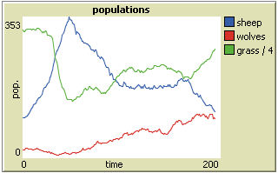
Gathering Information: Plots and Monitors
Plot
Monitor

Slide 18
Controlling the View
. Press "setup" and then "go" to start the model running.
. As the model runs, move the speed slider to the left.
What happens?
This slider is helpful if a model is running too fast for you to see what's going on in detail.
. Move the speed slider to the middle.
. Try moving the speed slider to the right.
. Now try checking and unchecking the view updates checkbox.
What happens?

Slide 19
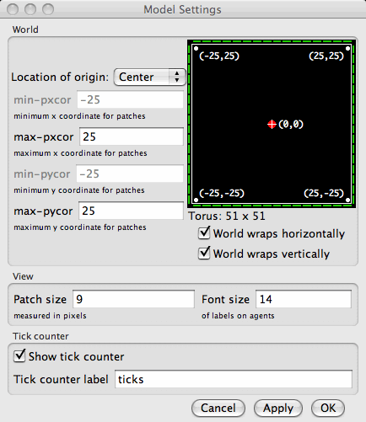
Press “Settings”

Slide 20
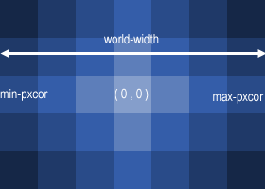
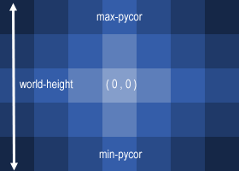
In these diagrams, max-pxcor is 3 , min-pxcor is -3, max-pycor is 2 and min-pycor is -2.

Slide 21
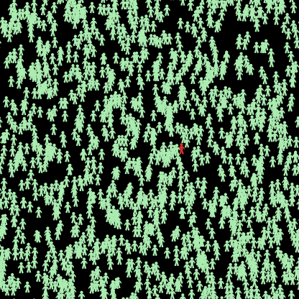
Tutorial 2: Typhoid Fever- A sample model from NetLogo User Community.
Typhoid fever is an infectious water borne disease caused by Salmonella typhii.
An epidemic simulation of typhoid fever
was made to see the possibility typhoid spreading in population.

Slide 22
Three independent variables that give influence for possibility become complicated or not.
LEVEL OF DESTRUCTION : The variable level of destruction, the highest is completely destroyed , lowest is no destruction.
HUMANITARIAN ASSISTANCE : The variable that support for recovering people like education level (they know how to prevent and first aid), health facilities, rapid medical assistance and treatments.
EDUCATION : Education background turtles are, 1 (elementary), 2 (junior), 3 (senior), 4 (College)

Slide 23
Initialization of the model (create certain
amount of people with certain proportion have Typhoid)
People get older
Move
Infect
Recover
Reproduce
….
Every tick (simulation time
step)
Output, visualization of the results

Slide 24
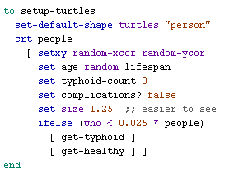
Initialize turtles
how long the turtle has typhoid fever
Return turtle’s ID

Slide 25
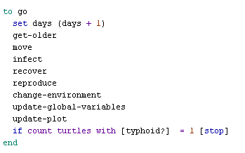
“go” procedure (execute every tick)

Slide 26
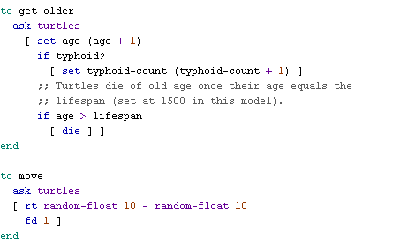
“get-old” and “move” procedures
Turtle will be removed from simulation
Turtle turns right by number of degree

Slide 27
“Infect” procedure
The larger level-destruction, the higher chance people get Typhoid

Slide 28
“recover” procedure
The higher education level, the less need for humanitarian-assistance
The higher humanitarian-assistance, more chance to get healthy

Slide 29
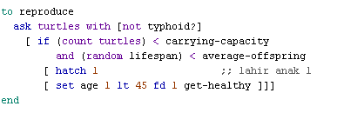
“reproduce” procedure
Limiting the total amount of people
Create an identify turtle as partent

Slide 30
SPARK is available at:
www.pitt.edu/~cirm/SPARK

