Slide 1
EPIDEMIOLOGY: Some sample Agent-based epidemic models
Dr. Qi Mi
Department of Sports Medicine and Nutrition, SHRS, Univ. of Pitt

Slide 2
Contact Information
Qi Mi, Ph.D. Assistant Professor Center for Inflammation and Regenerative Modeling Department of Sports Medicine and Nutrition University of Pittsburgh 6072 Forbes Tower Phone: 412-383-6733
Email: qim3@pitt.edu
Office hour: Monday 2-4

Slide 3
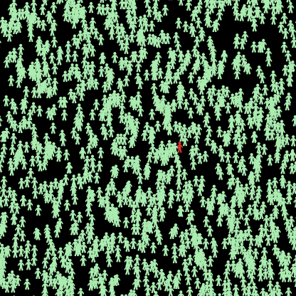
Typhoid Fever: A sample model from NetLogo User Community.
Typhoid fever is an infectious water borne disease caused by Salmonella typhii.
An epidemic simulation of typhoid fever
was made to see the possibility typhoid spreading in population.

Slide 4
Three independent variables that give influence for possibility become complicated or not.
LEVEL OF DESTRUCTION : The variable level of destruction, the highest is completely destroyed , lowest is no destruction.
HUMANITARIAN ASSISTANCE : The variable that support for recovering people like education level (they know how to prevent and first aid), health facilities, rapid medical assistance and treatments.
EDUCATION : Education background turtles are, 1 (elementary), 2 (junior), 3 (senior), 4 (College)

Slide 5
Initialization of the model (create certain
amount of people with certain proportion have Typhoid)
People get older
Move
Infect
Recover
Reproduce
….
Every tick (simulation time
step)
Output, visualization of the results

Slide 6
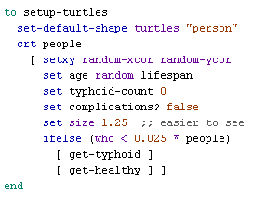
Initialize turtles
how long the turtle has typhoid fever
Return turtle’s ID

Slide 7
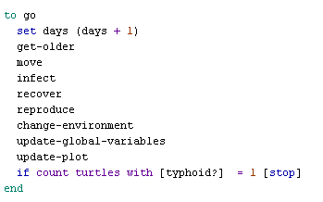
“go” procedure (execute every tick)

Slide 8
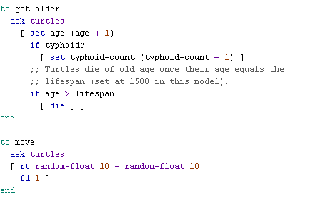
“get-old” and “move” procedures
Turtle will be removed from simulation
Turtle turns right by number of degree

Slide 9
“Infect” procedure
The larger level-destruction, the higher chance people get Typhoid

Slide 10
“recover” procedure
The higher education level, the less need for humanitarian-assistance
The higher humanitarian-assistance, more chance to get healthy

Slide 11
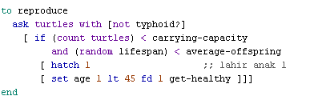
“reproduce” procedure
Limiting the total amount of people
Create an identify turtle as partent

Slide 12
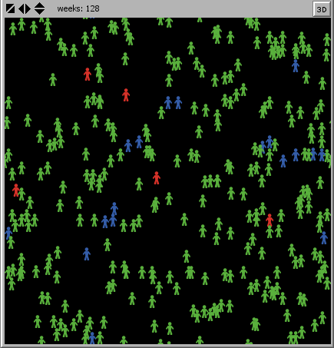
AIDS: A sample model from NetLogo Models Library.
This model simulates the spread of the
human immunodeficiency virus (HIV),
via sexual transmission, through a small
isolated human population.
It therefore illustrates the effects of certain
sexual practices across a population.

Slide 13
How HIV spreads
Healthy
Infected, but unknown
Infected, known
Infected, but unknown
Infected, but unknown
Infected, known

Slide 14
The model examines the emergent effects of four aspects of sexual behavior.
The population’s tendency to practice abstinence
how changes in sexual mores in our society have contributed to increases in the prevalence of sexually transmitted diseases
The amount of time an average "couple"
in the population will stay together
The population's tendency to use condoms
It may provide contemporary solutions
to the problem.
The population's tendency to get tested for HIV.

Slide 15
Homework project
Choose a disease
Find variables which can influence the spread of the disease
Form a three-people team and turn in the homework at the end of the course(Jun 16)
Write a code and a report
2 updates, one is for deciding the topic (May 28), second one is for draft of the code (Jun 11).

