Slide 1
Intro to Data Mining: Extracting Information and Knowledge from Data
Notes:
1

Slide 2
Topics
Relationships between DSS/BI, database, data management
DSS/BI: transforming data into info to support decision making
How operational data and DSS/BI data differ
What a data warehouse is, how data for it are prepared, and how it is implemented
Multidimensional database
Database technology for BI: OLAP, OLTP
Examples of applications in healthcare

Slide 3
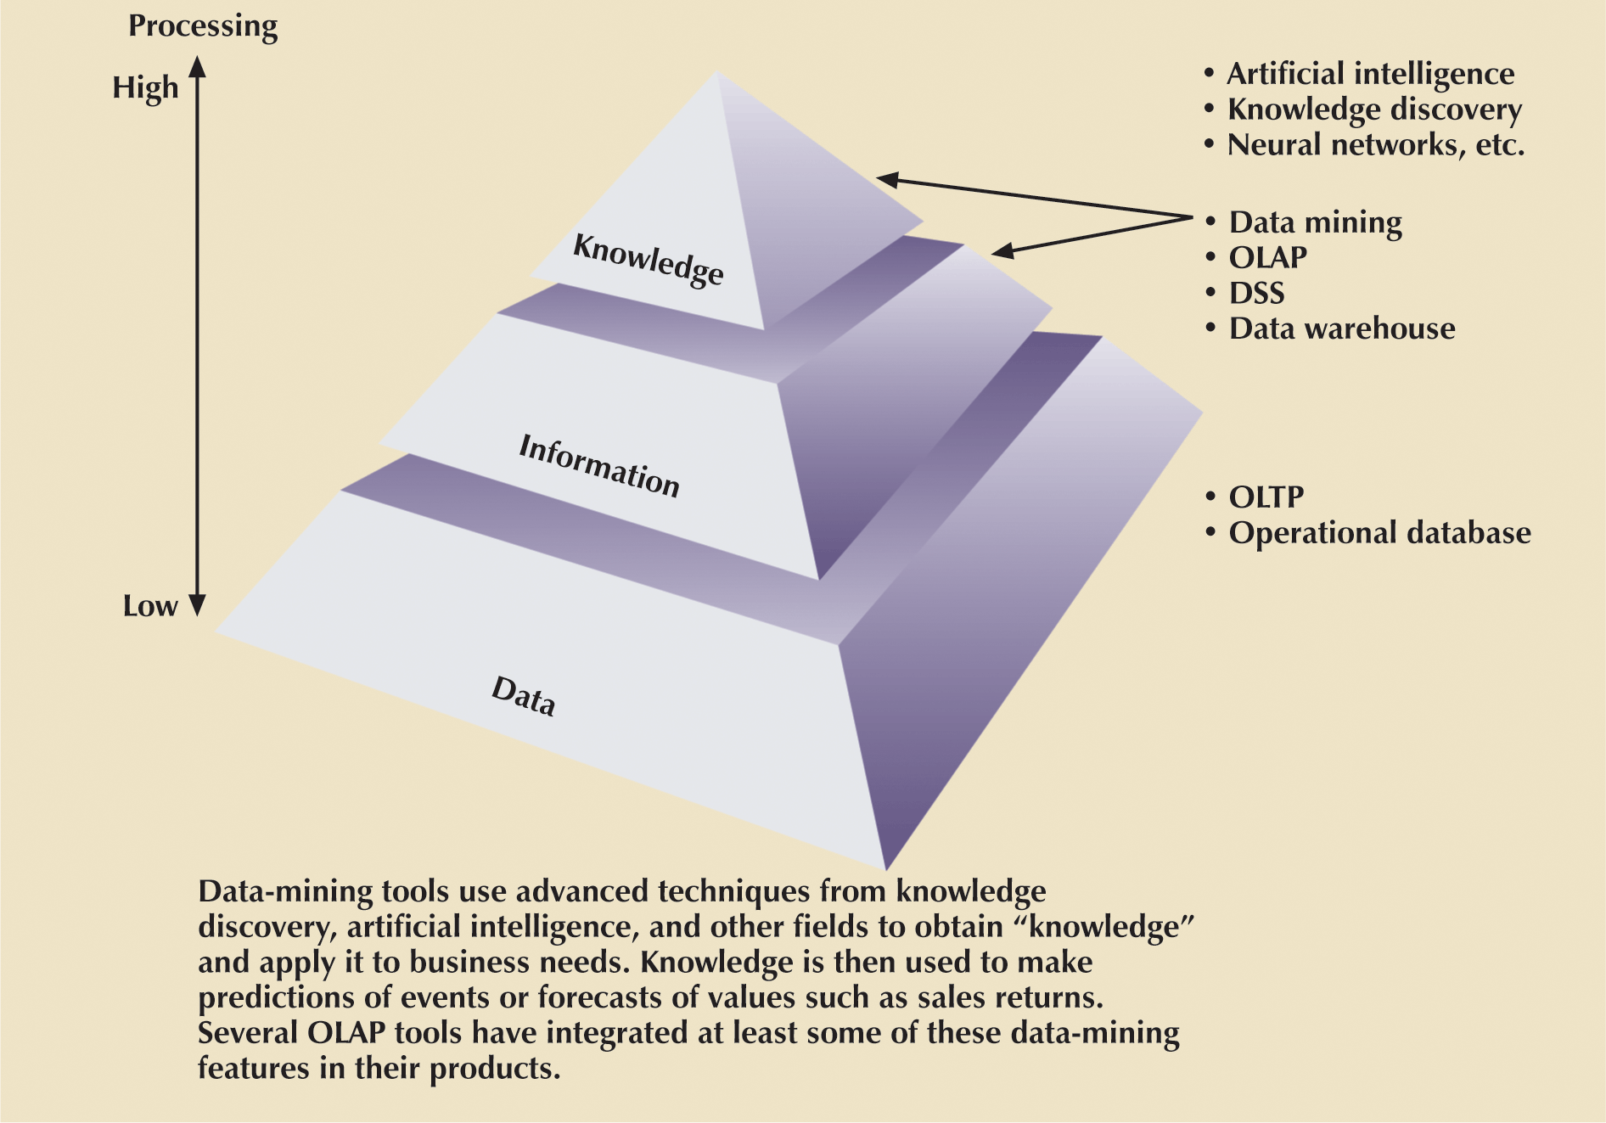
BI: Extraction Of Knowledge From Data
Notes:
55

Slide 4
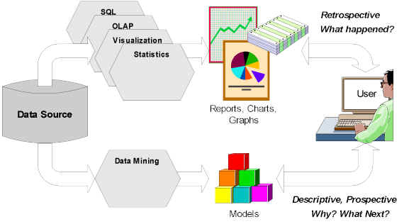
DSS/BI Architecture: Learning and Predicting
Courtesy: Tim Graettinger

Slide 5
DSS/BI
DSS/BI are technologies designed to extract information from data and to use such information as a basis for decision making
Decision support system (DSS)
  Arrangement of computerized tools used to assist managerial decision making within business
  Usually requires extensive data “massaging” to produce information
  Used at all levels within organization
  Often tailored to focus on specific business areas
  Provides ad hoc query tools to retrieve data and to display data in different formats

Slide 6
DSS/BI Components
Data store component
  Basically a DSS database
Data extraction and data filtering component
  Used to extract and validate data taken from operational database and external data sources
End-user query tool
  Used to create queries that access database
End-user presentation tool
  Used to organize and present data

Slide 7
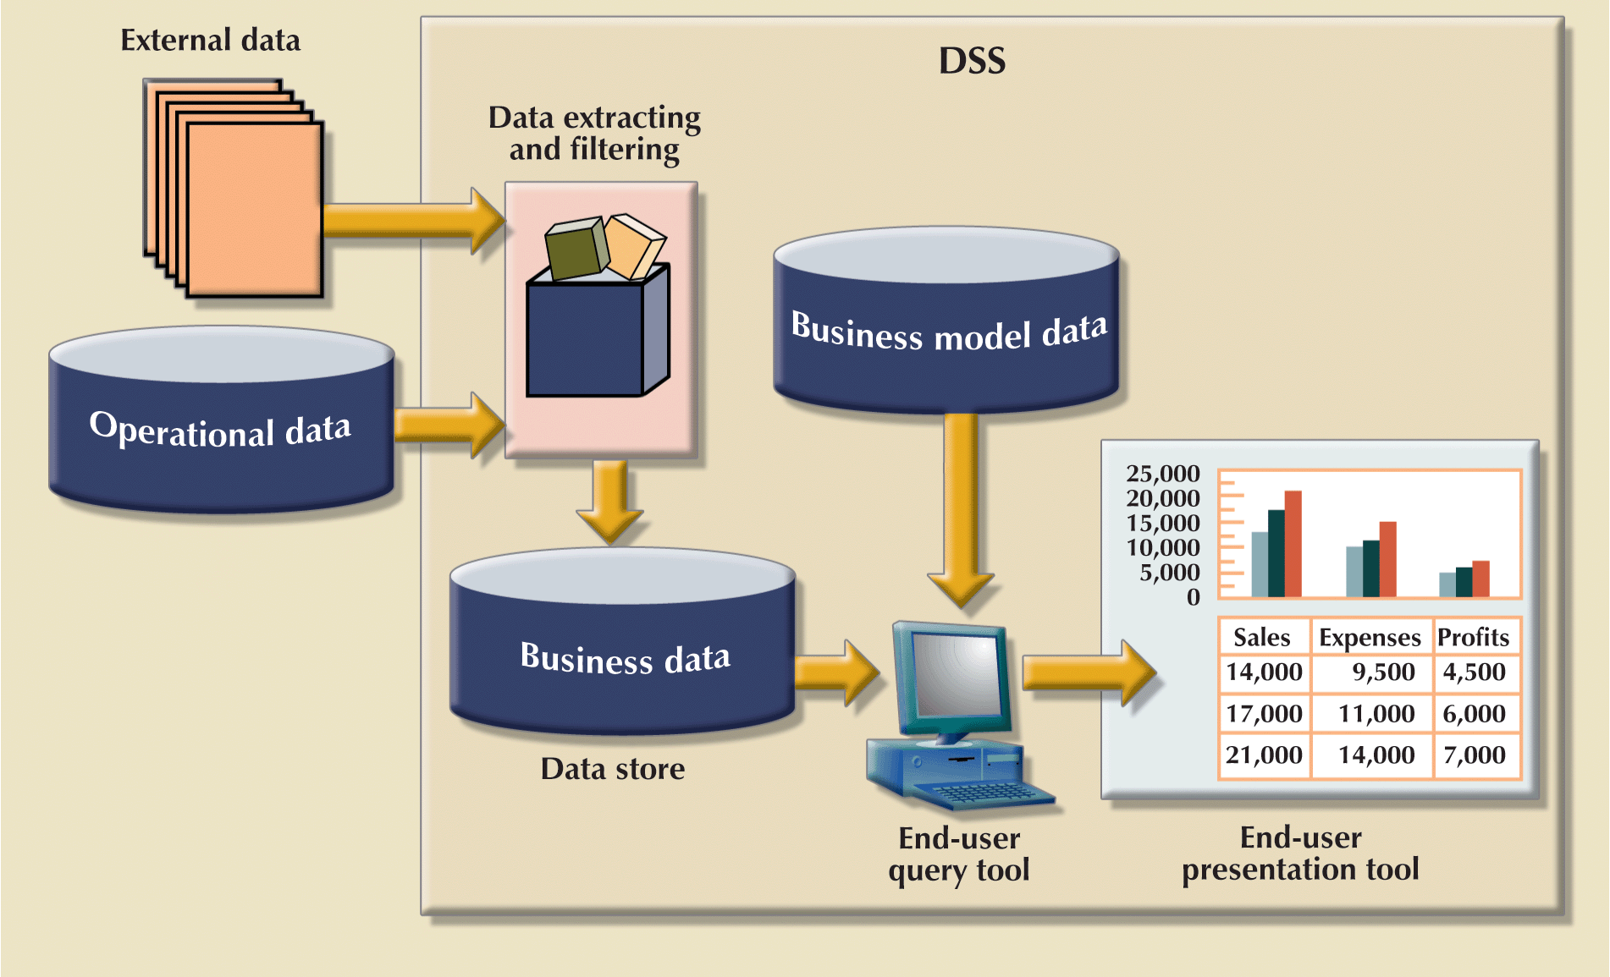
Main Components Of A DSS/BI
Notes:
7

Slide 8
DSS/BI: Needs a different type of database
A specialized DBMS tailored to provide fast answers to complex queries.
Database schema
  Must support complex data representations
  Must contain aggregated and summarized data
  Queries must be able to extract multidimensional time slices
Database size: DBMS must support very large databases (VLDBs), Wal-Mart data warehouses is measured in petabyte (1,000 terabyte)
Technology: Data warehouse and OLAP

Slide 9
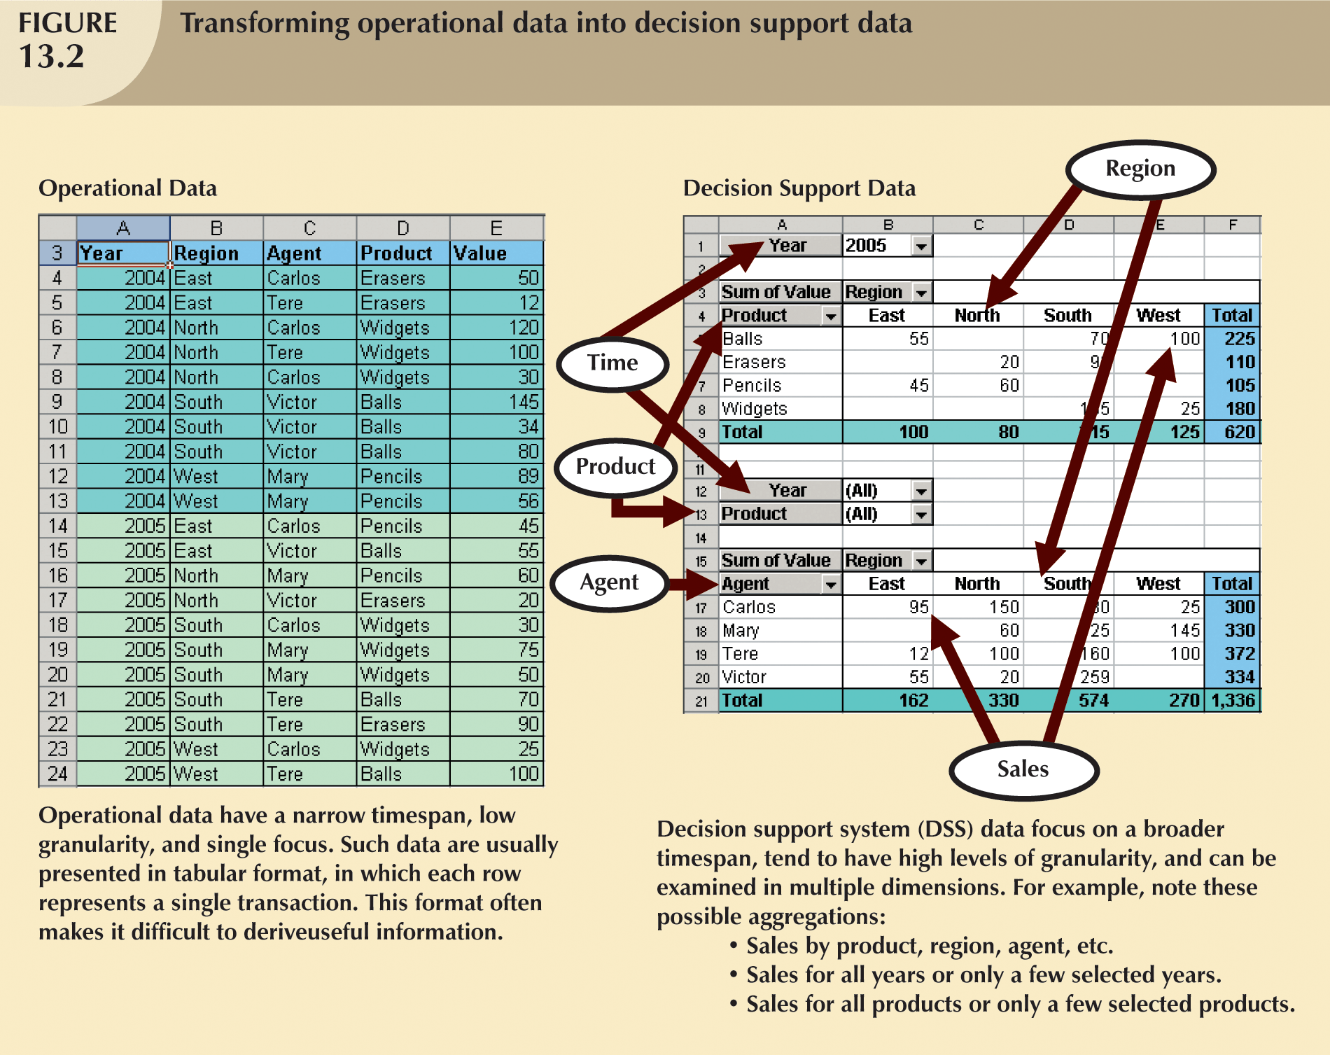
Operational vs. DSS/BI Data
Notes:
7

Slide 10
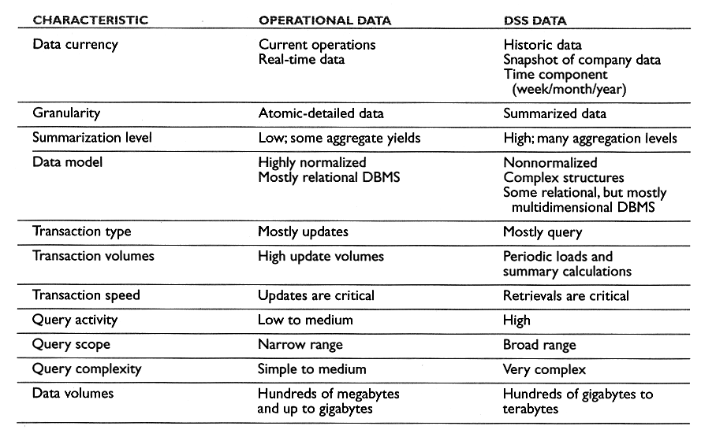
Operational vs DSS Data

Slide 11
What is Data Warehouse?
The Data Warehouse is an integrated, subject-oriented, time-variant, non-volatile database that provides support for decision making.
Usually a read-only database optimized for data analysis and query processing
centralized, consolidated database
periodically updated, never removed
Requires time, money, and considerable managerial effort to create
Notes:
13

Slide 12
OLAP (Online Analytical Processing)
Advanced data analysis environment that supports decision making, business modeling, and operations research
“engine” or platform for DSS or Data Warehouse
OLAP systems share four main characteristics:
  Use multidimensional data analysis techniques
  Provide advanced database support
  Provide easy-to-use end-user interfaces
  Support client/server architecture

Slide 13
OLAP vs OLTP
Online Transactional Processing (OLTP)
  emphasize speed, security, flexibility, reduce redundancy and abnormalities.
Online Analytical Processing (OLAP)
  multi-dimensional data analysis
  advanced database support
  easy-to-use user interface
  support client/server architecture

Slide 14
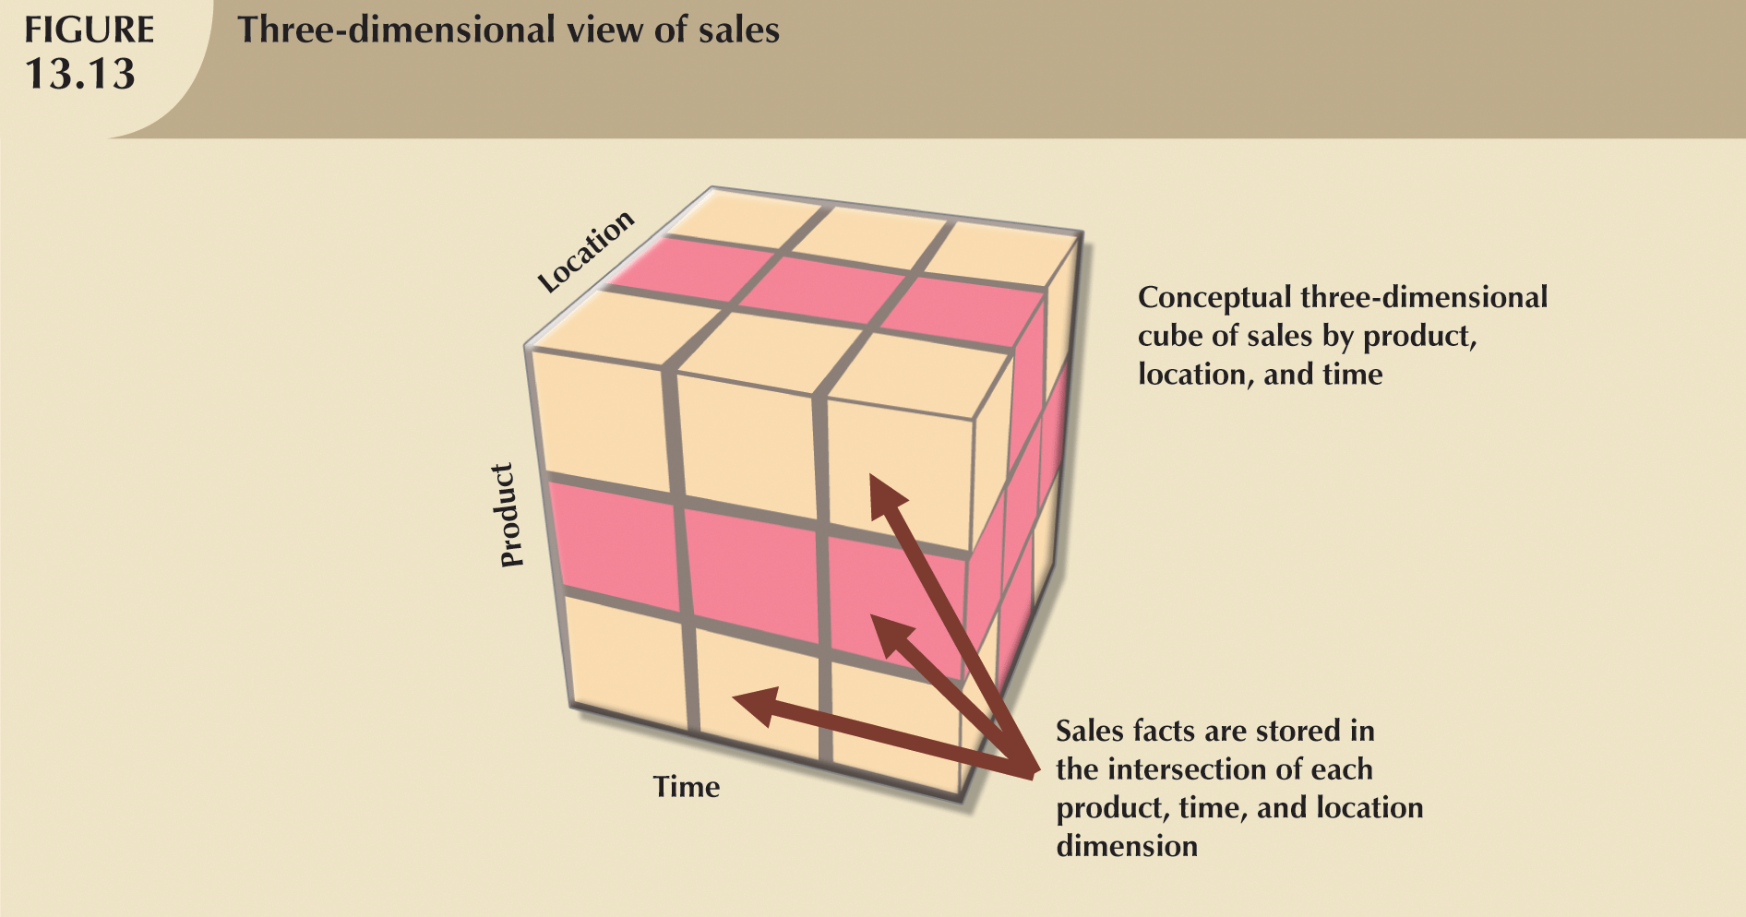
Multidimensional Data Analysis
Goal: analyze data from different dimensions and different levels of aggregation

Slide 15
Multidimensional Data Analysis Techniques
Data are processed and viewed as part of a multidimensional structure
Particularly attractive to business decision makers
Augmented by following functions:
  Advanced data presentation functions
  Advanced data aggregation, consolidation and classification functions
  Advanced computational functions
  Advanced data modeling functions

Slide 16
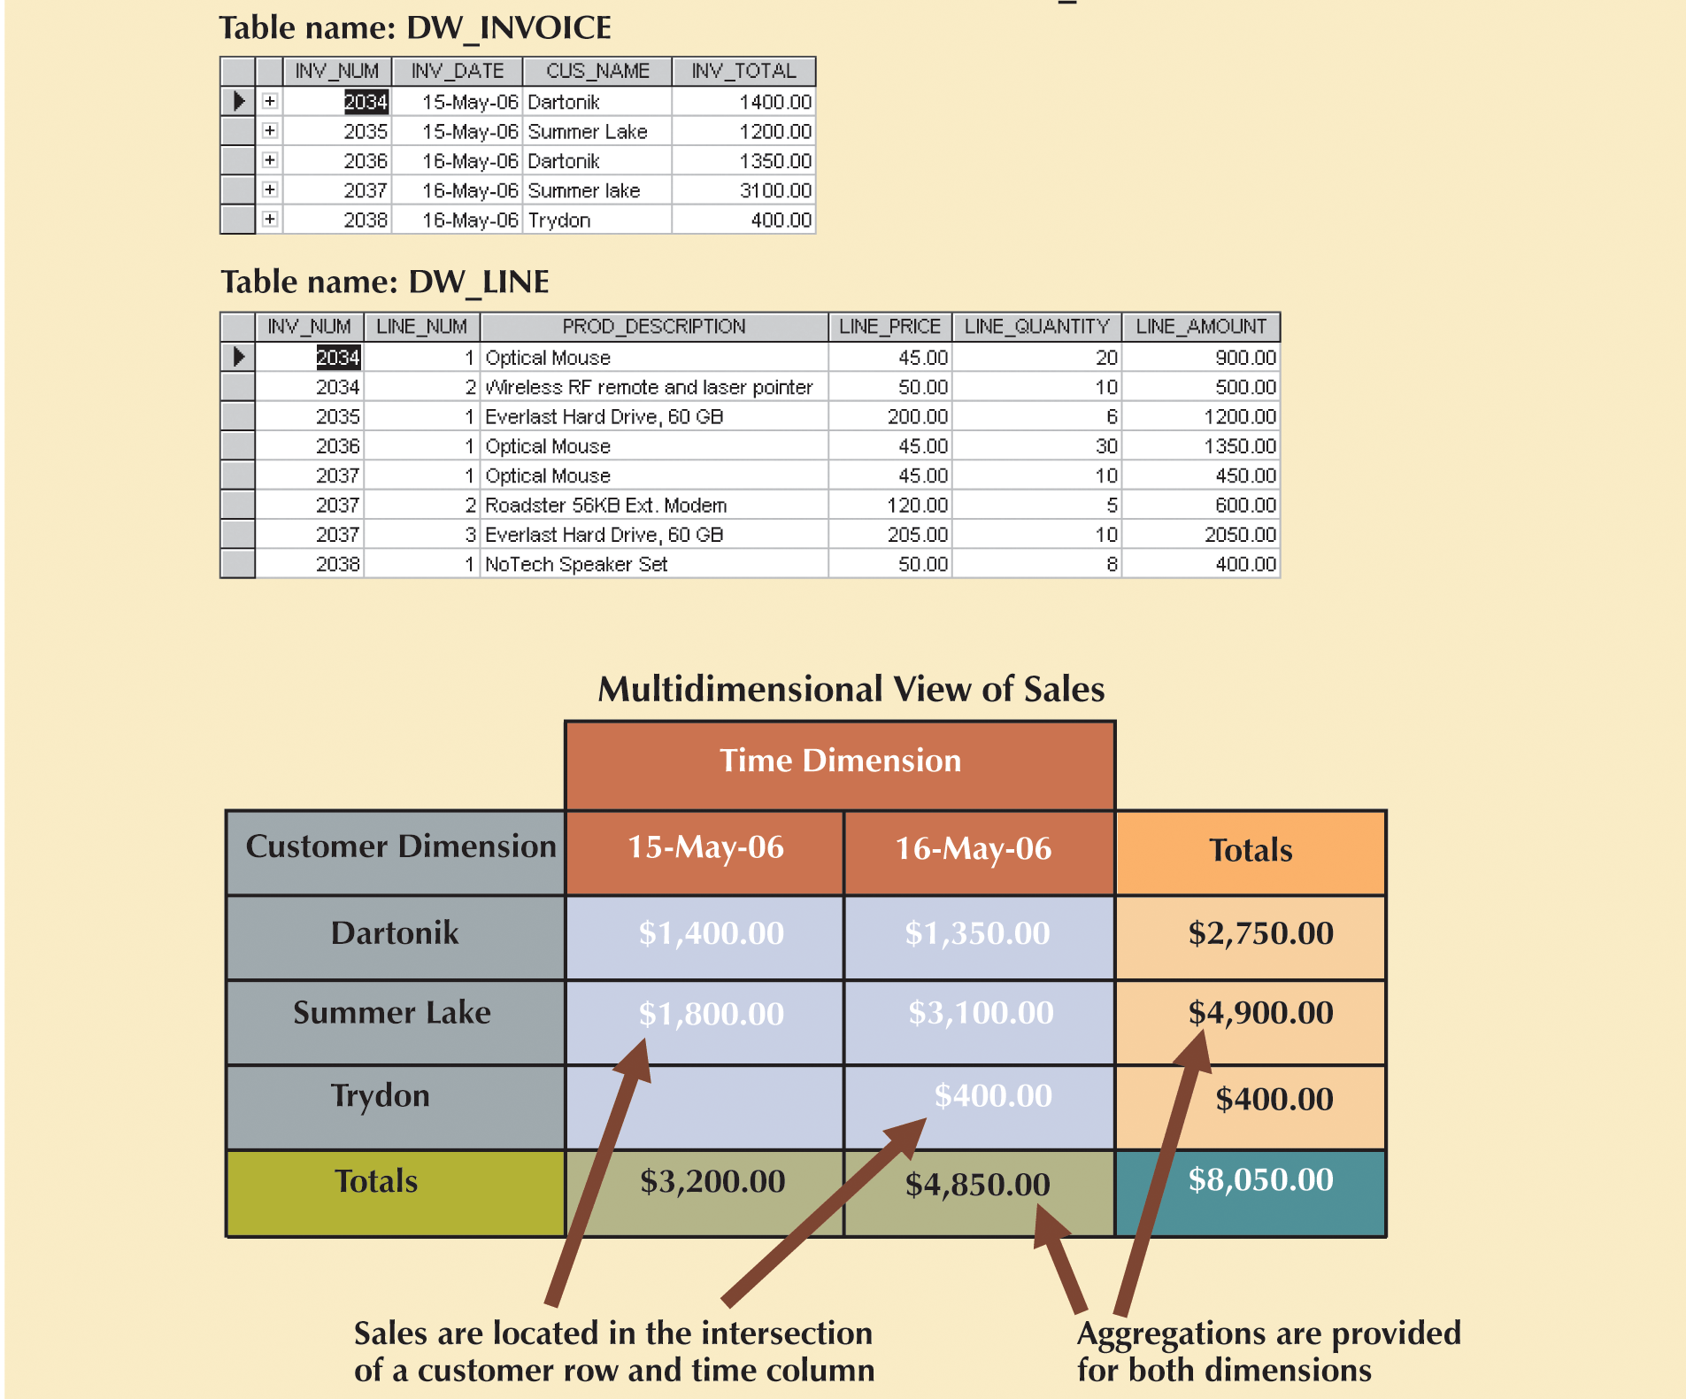
Multidimensional Data Analysis: Operational vs multidimensional view

Slide 17
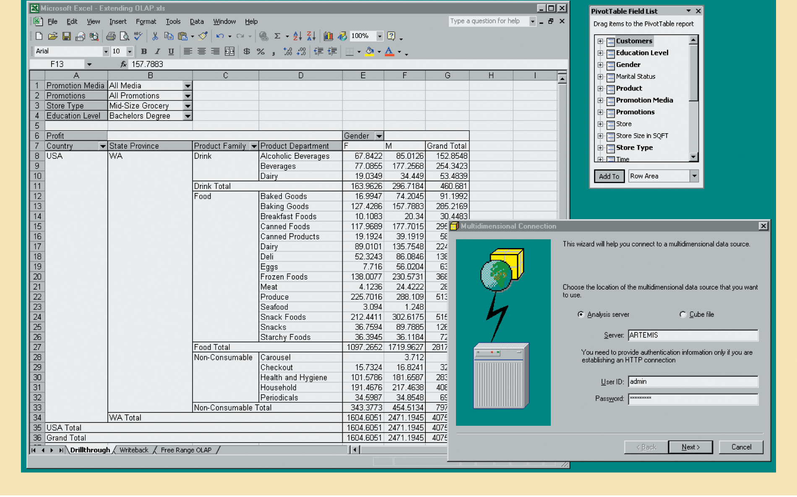
Integration OLAP with Spreadsheet

Slide 18
Easy-to-Use End-User Interface
Many of interface features are “borrowed” from previous generations of data analysis tools that are already familiar to end users
  Makes OLAP easily accepted and readily used

Slide 19
Client/Server Architecture
Provides framework within which new systems can be designed, developed, and implemented
  Enables OLAP system to be divided into several components that define its architecture
  OLAP is designed to meet ease-of-use as well as system flexibility requirements

Slide 20
OLAP Architecture
Designed to use both operational and data warehouse data
Defined as an “advanced data analysis environment that supports decision making, business modeling, and an operation’s research activities”
In most implementations, data warehouse and OLAP are interrelated and complementary environments

Slide 21
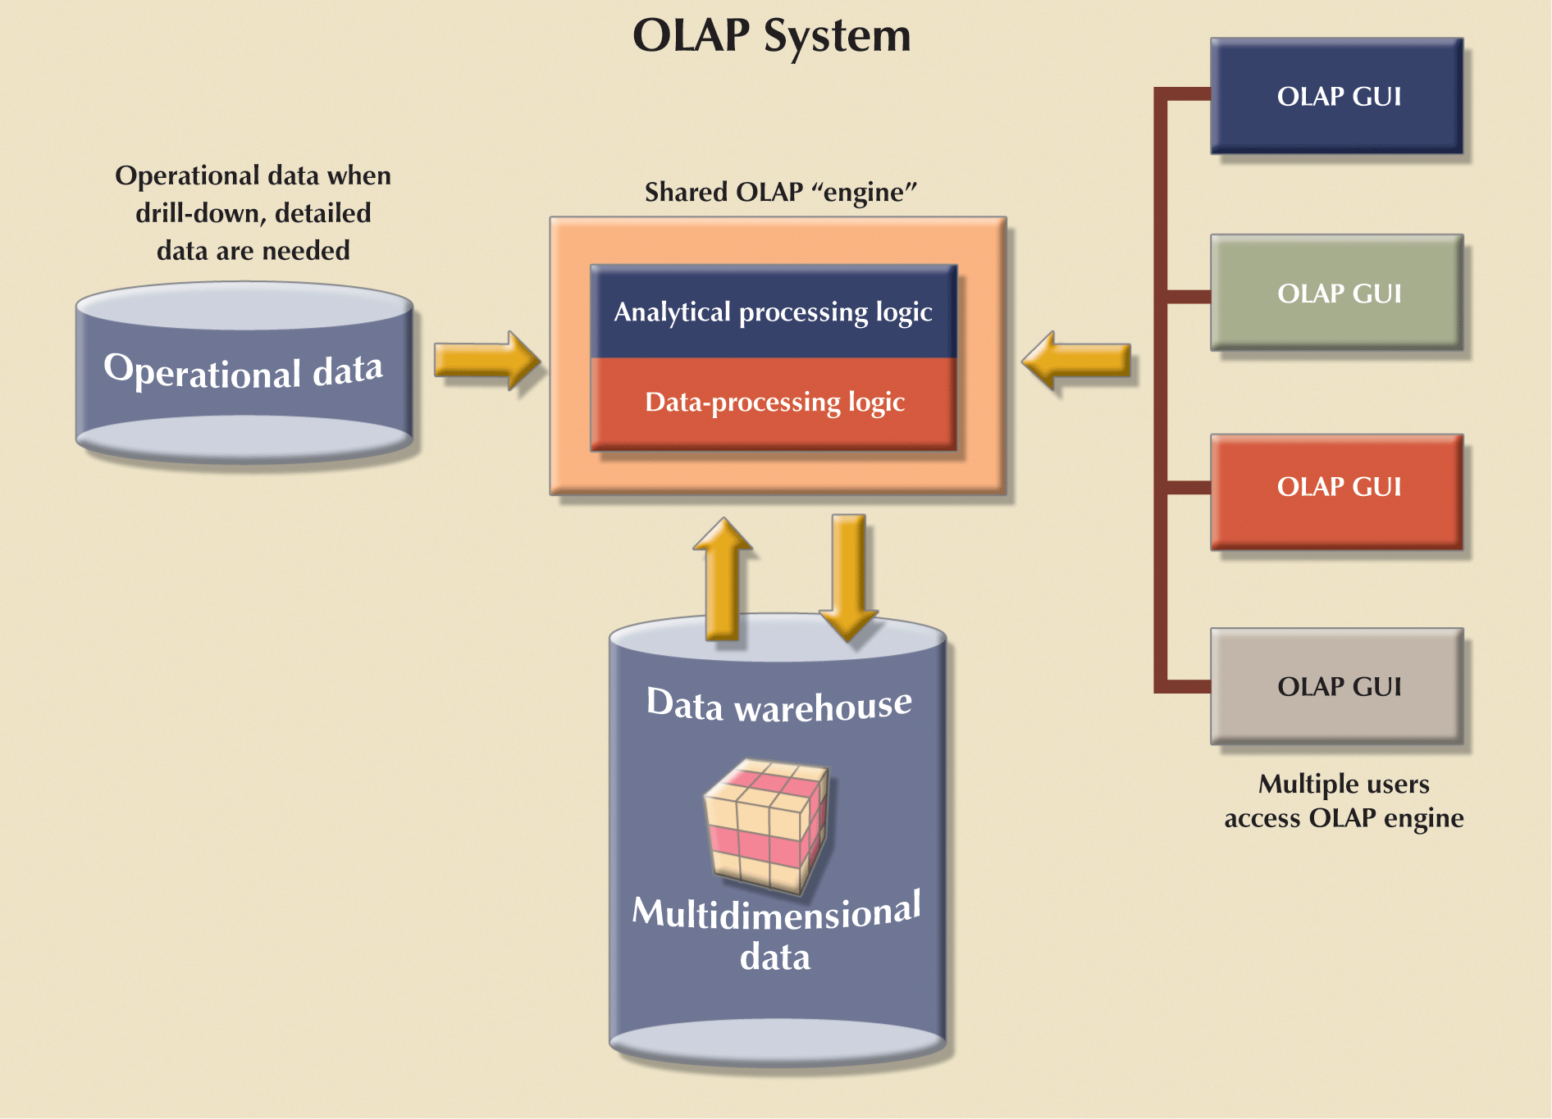
OLAP Architecture: OLAP engine provides ETL (DTS) functions

Slide 22
Relational OLAP
Provides OLAP functionality by using relational databases and familiar relational query tools to store and analyze multidimensional data
Adds following extensions to traditional RDBMS:
  Multidimensional data schema support within RDBMS
  Data access language and query performance optimized for multidimensional data

Slide 23
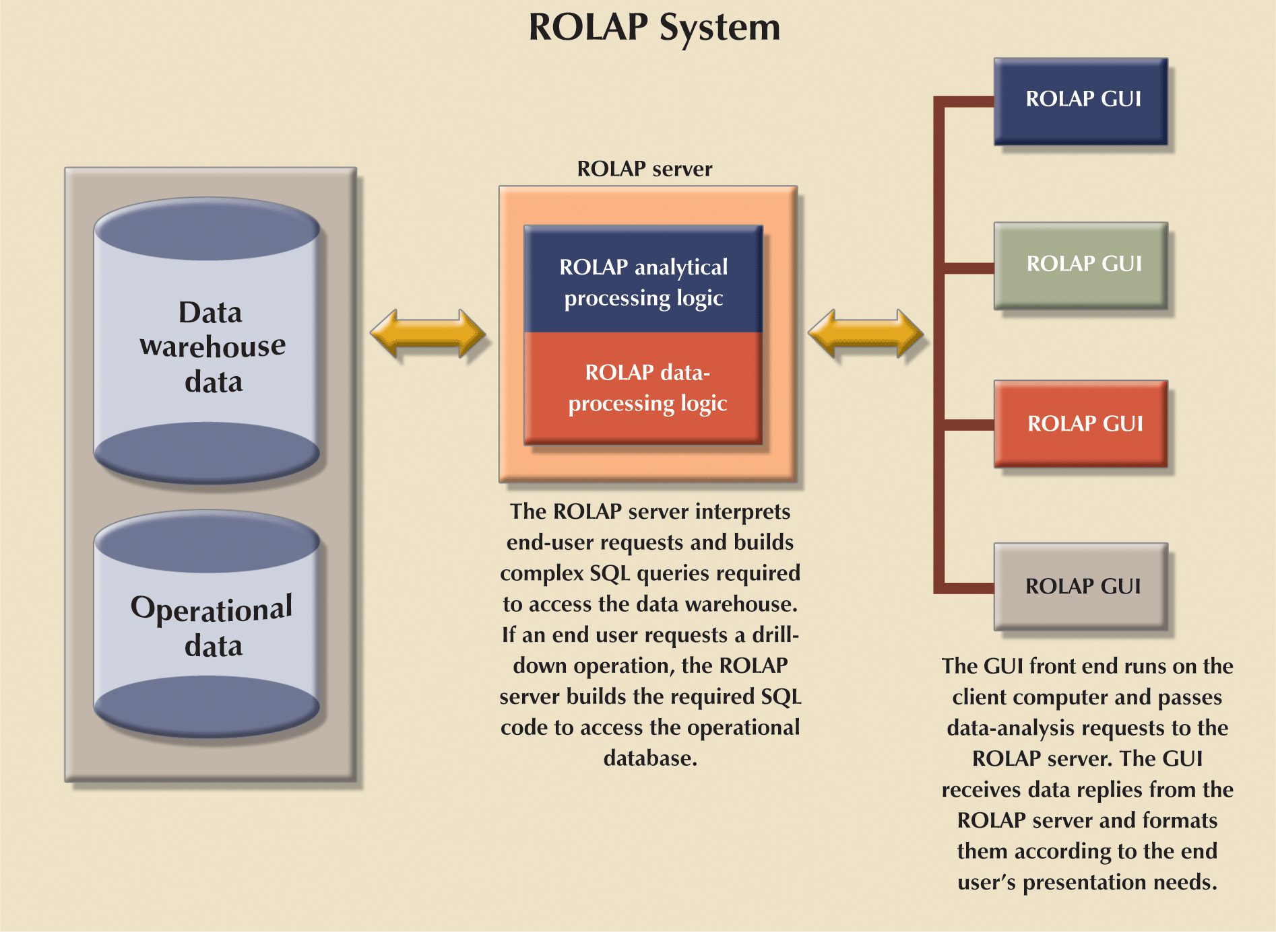
Relational OLAP (ROLAP)

Slide 24
Multidimensional OLAP (MOLAP)
Extends OLAP functionality to multidimensional database management systems (MDBMSs)
  MDBMS end users visualize stored data as a 3D cube-a data cube
  Data cubes can grow to n number of dimensions, becoming hypercubes
  To speed access, data cubes are held in memory in a cube cache

Slide 25
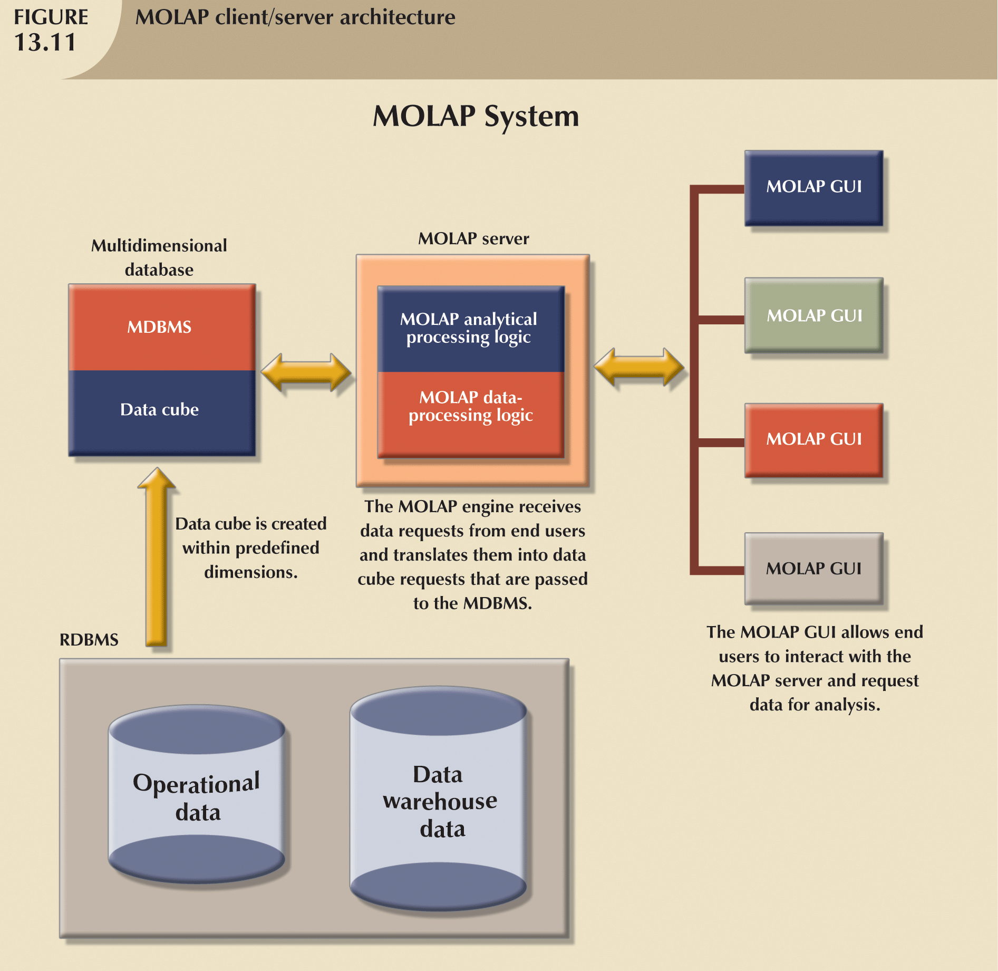
Multidimensional OLAP

Slide 26
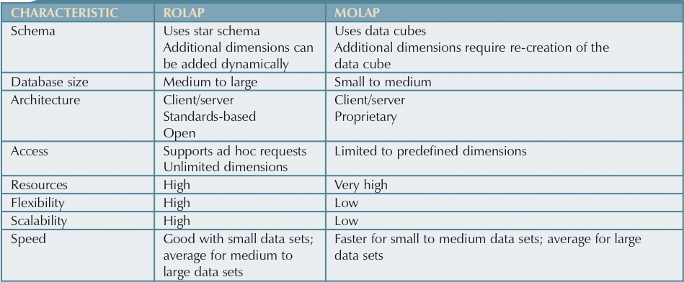
Relational vs. Multidimensional OLAP

Slide 27
Star Schemas
Data modeling technique used to map multidimensional decision support data into relational database
Creates near equivalent of multidimensional database schema from existing relational database
Yield an easily implemented model for multidimensional data analysis, while still preserving relational structures on which operational database is built
Has four components: facts, dimensions, attributes, and attribute hierarchies

Slide 28
Facts
Numeric measurements (values) that represent specific business aspect or activity
  Normally stored in fact table that is center of star schema
Fact table contains facts that are linked through their dimensions
Metrics are facts computed or derived at run time

Slide 29
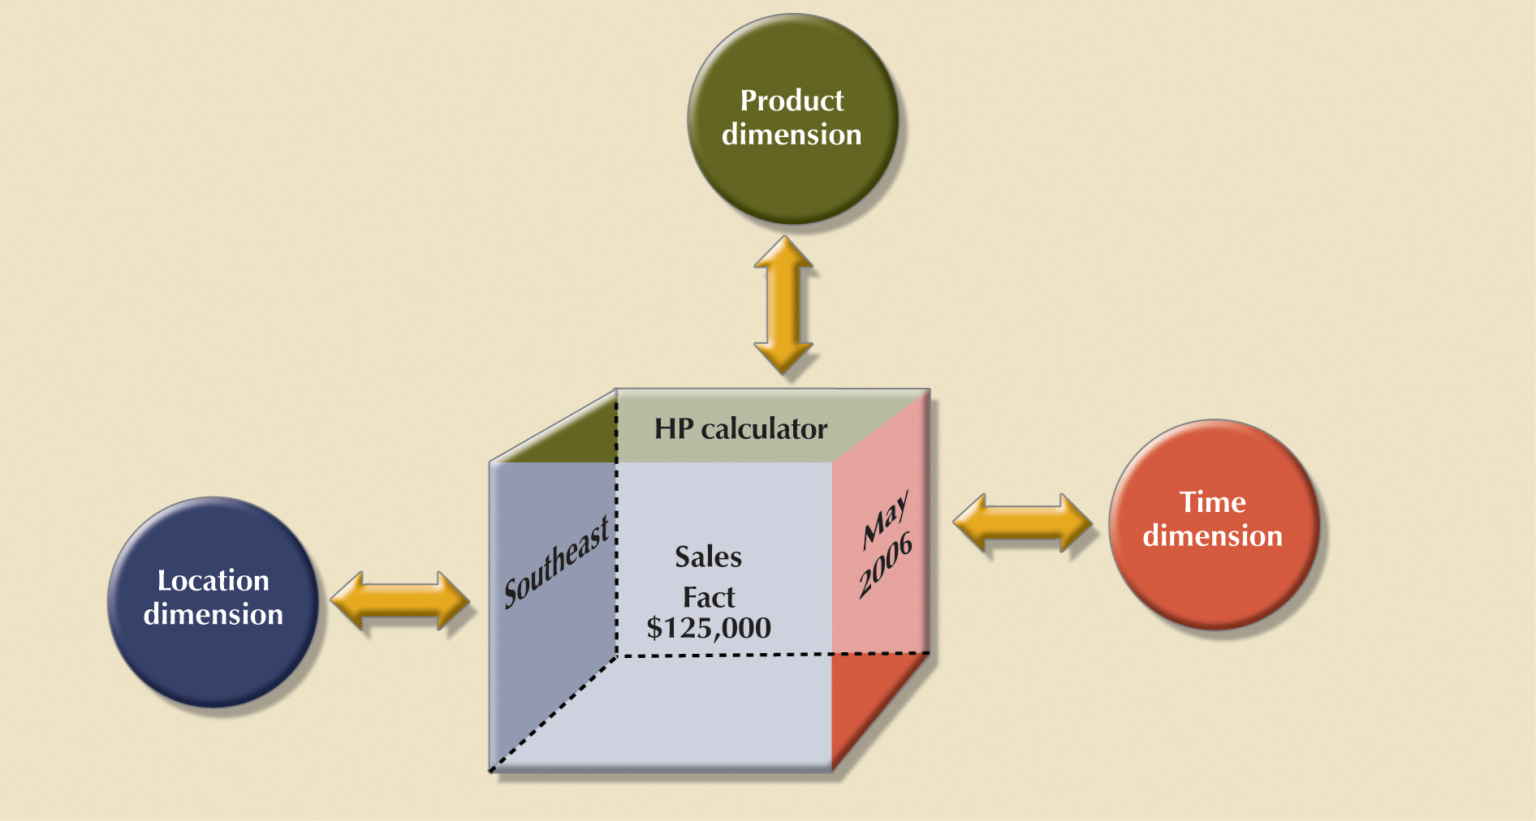
Dimensions: simple star schema
Notes:
42

Slide 30
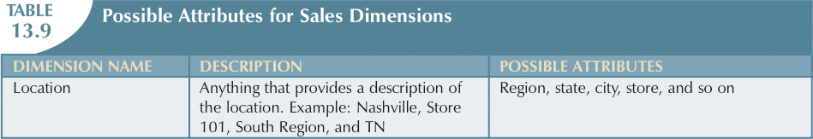
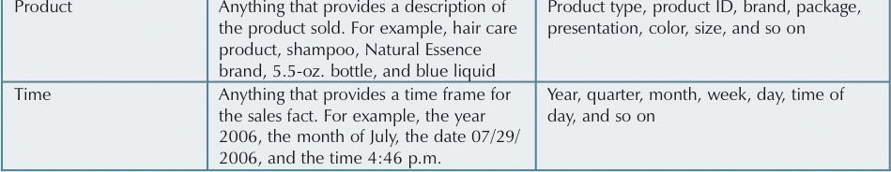
Attributes
Used to search, filter, or classify facts
Dimensions provide descriptive characteristics about the facts through their attributes

Slide 31
Attributes: Three-dimensional view of sales

Slide 32
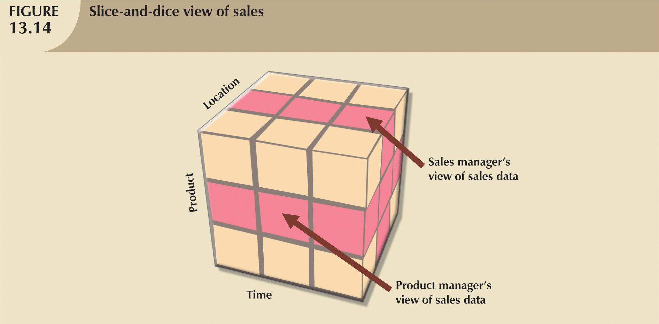
Attributes: slice-and-dice view of sales

Slide 33
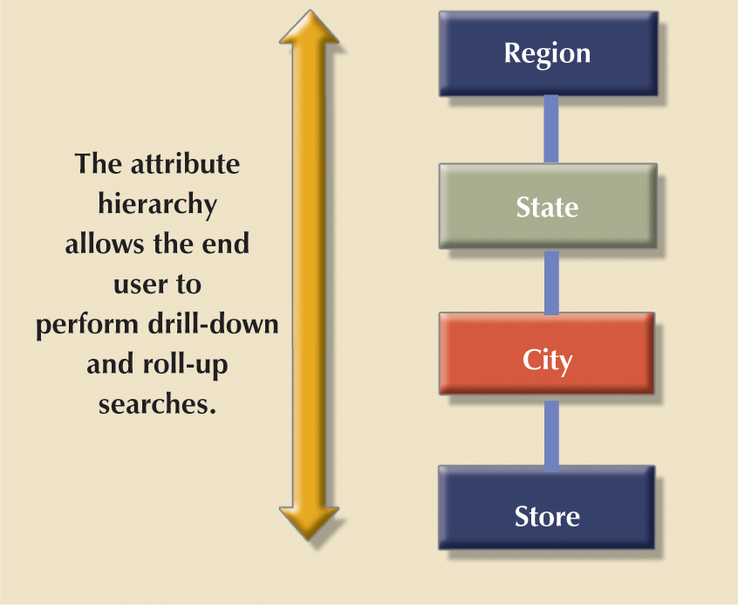
Attribute Hierarchies
Provides top-down data organization
Provides capability to perform drill-down and roll-up searches in a data warehouse

Slide 34
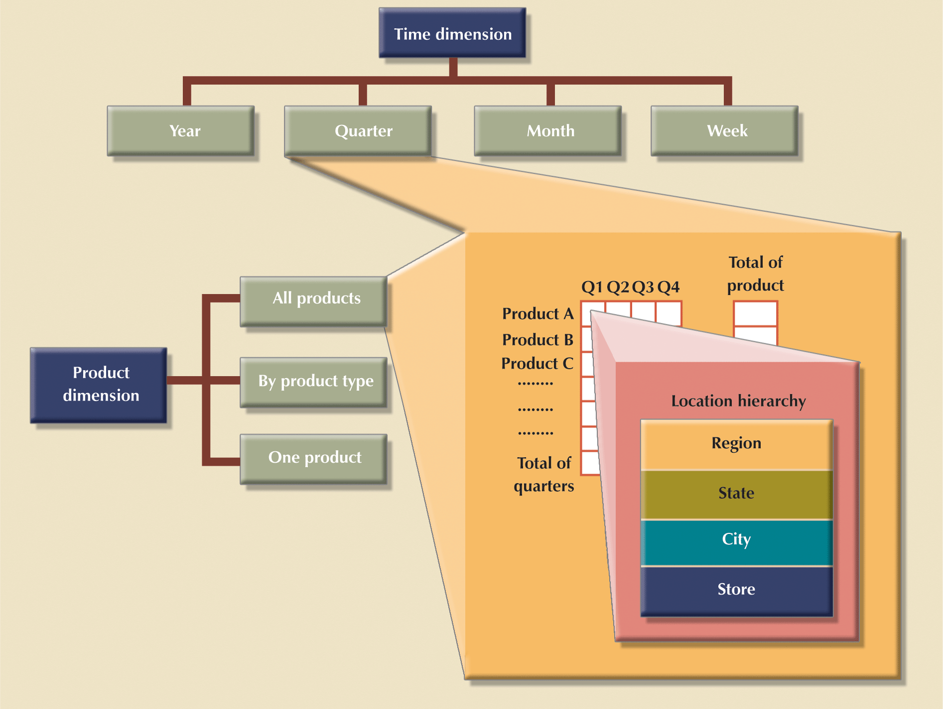
Attribute Hierarchies in multidimensional analysis

Slide 35
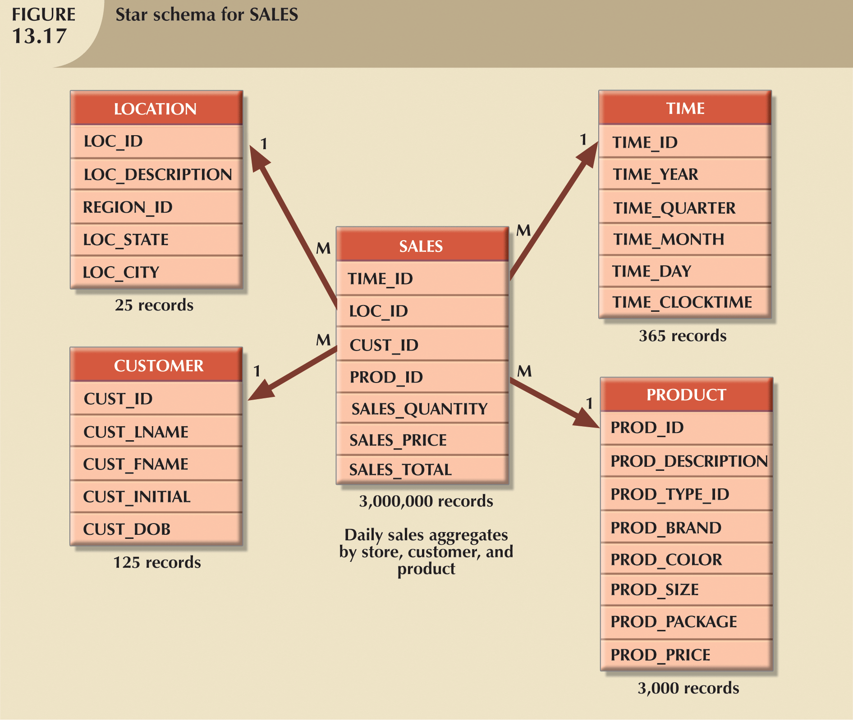
Star Schema Representation
Each dimension record is related to thousands of fact records
Facilitates data retrieval functions

Slide 36
Slice and Dice

Slide 37
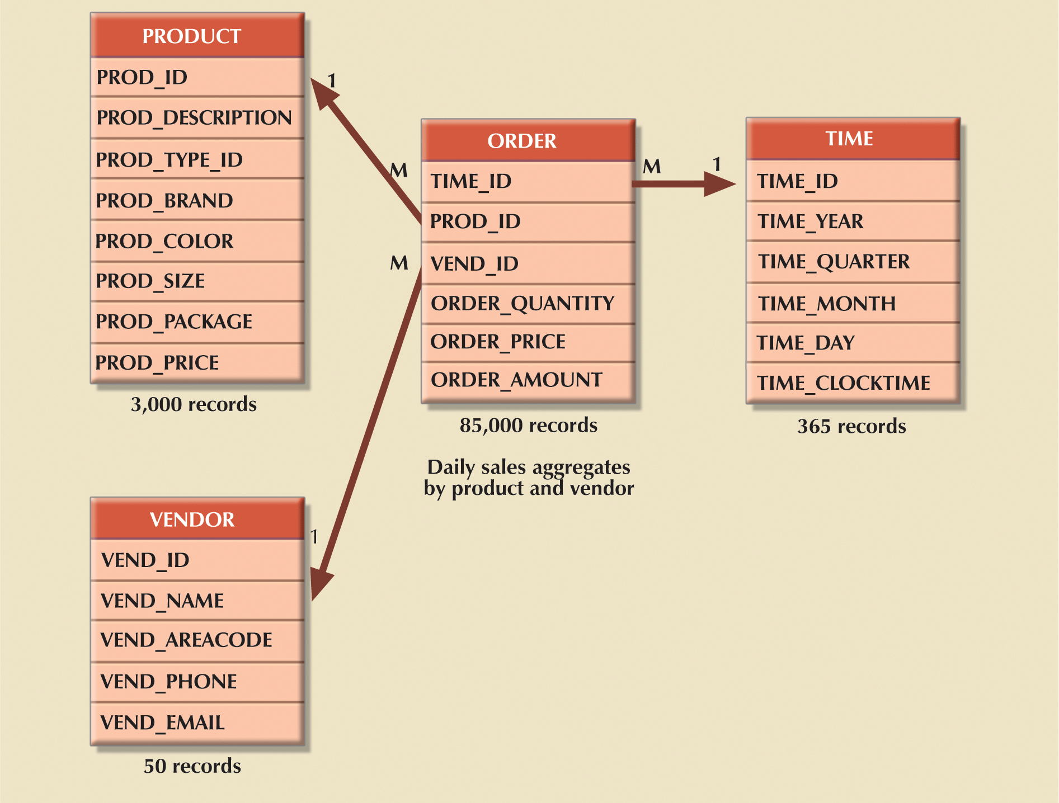
Star Schema Representation: order star schema

Slide 38
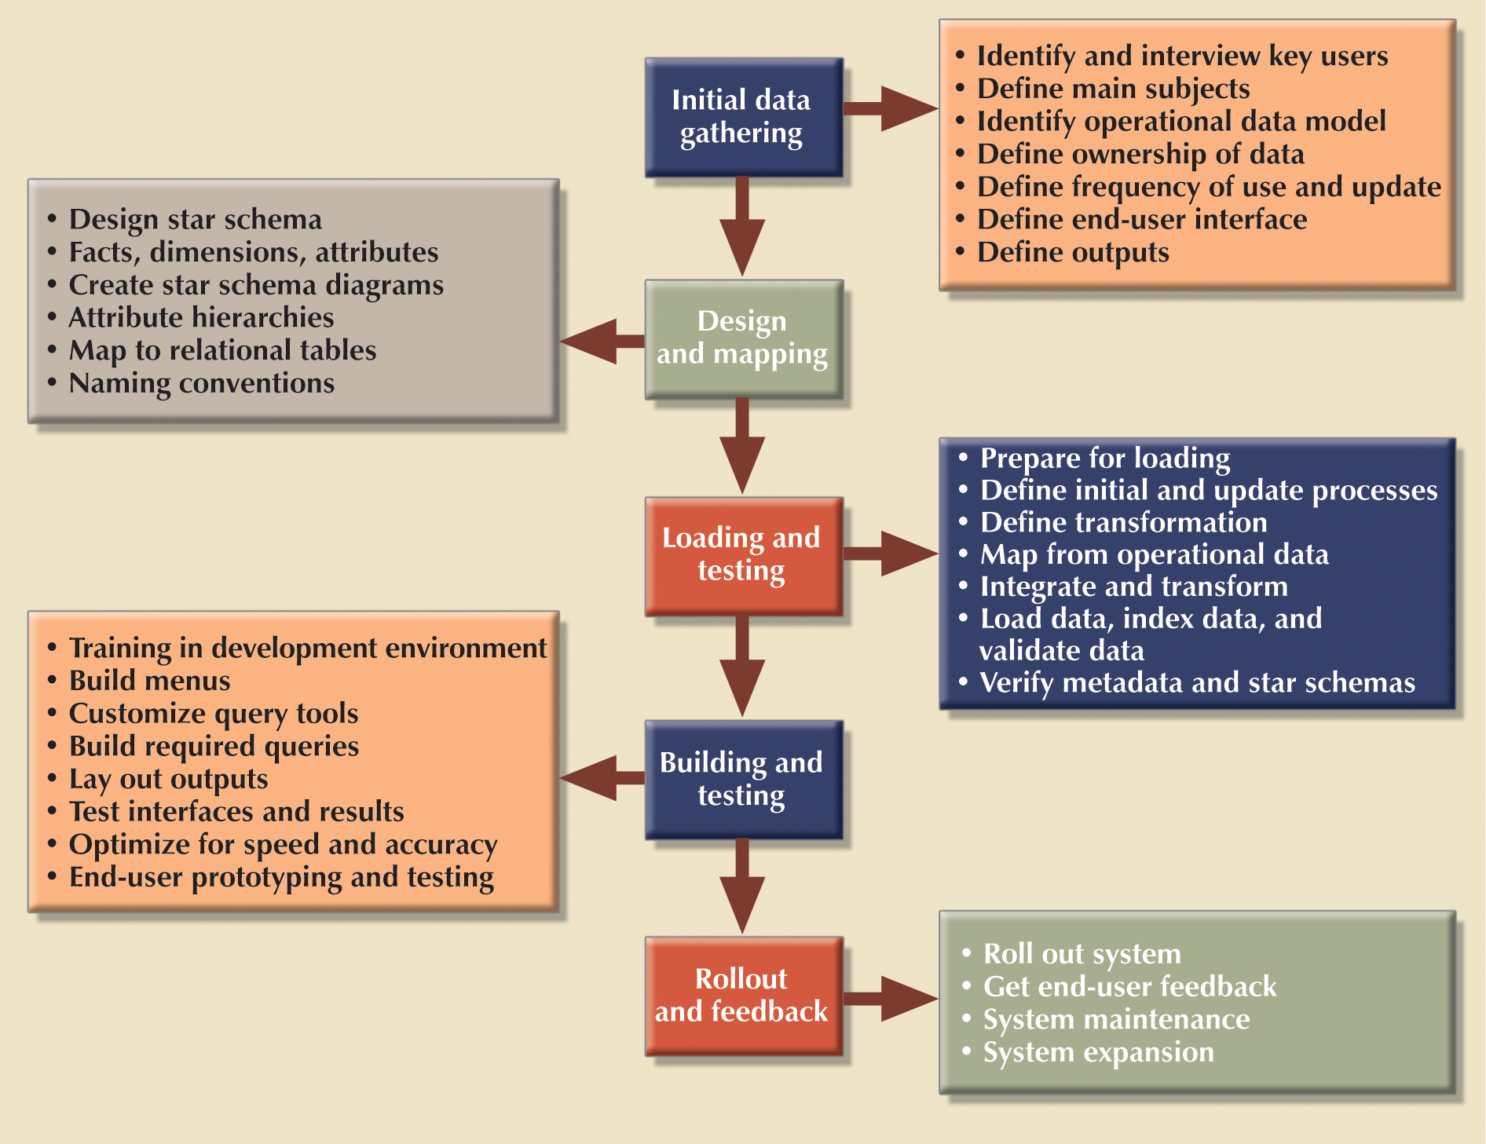
Apply Database Design Procedures: DW design and implementation

Slide 39
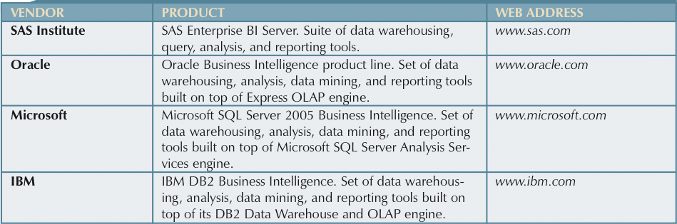
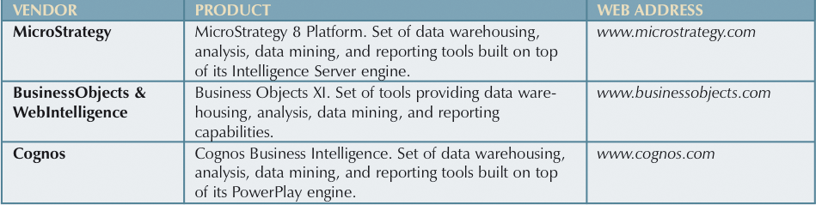
Data Warehouse Vendors

Slide 40
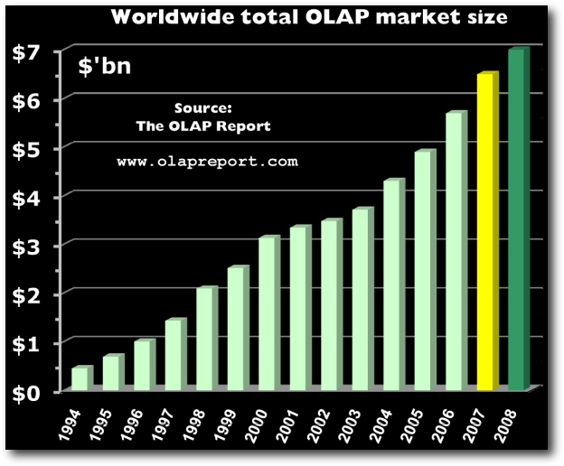
OLAP Market Size

Slide 41
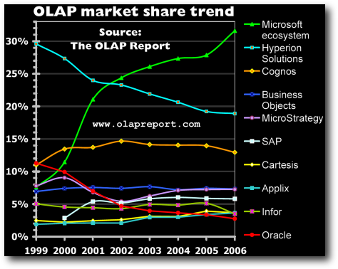
OLAP Market Share

Slide 42
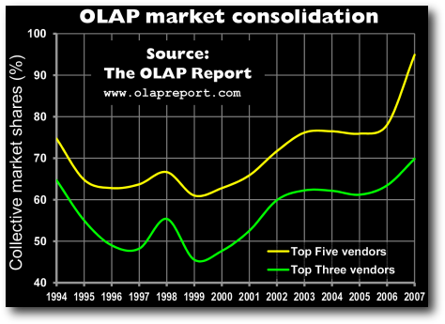
Market Consolidation

Slide 43
Latest Development
Oracle-Hyperion Merger
Cognos was bought by IBM
SPSS was bought by IBM

Slide 44
Application 1: Rehab Outcome Data Warehouse
Rehabilitation Outcome Database
Center for Rehabilitation Service (CRS) – UPMC
More than fifty community rehabilitation centers contributed to this database.
547,719 transactions
13 Outcome indicators, 72,541 episodes of treatment, 17,205 patients, 108 therapists, 48 institutions

Slide 45
Multi-dimensional database
dimension
Diagnosis
P_id
Disease
Status
Fact Table
P_id
D_id
A_id
T_id
no of patient
Demographic
D_id
gender
age
1 N
N 1
attribute
N
N
Area
A_id
Country
State
City
fact
Time
T_id
Year
Month
Week
1
1

Slide 46
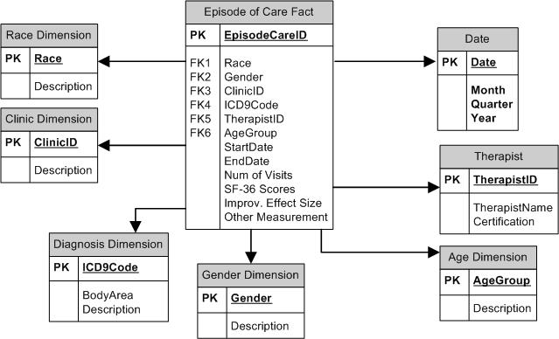
Star Schema

Slide 47
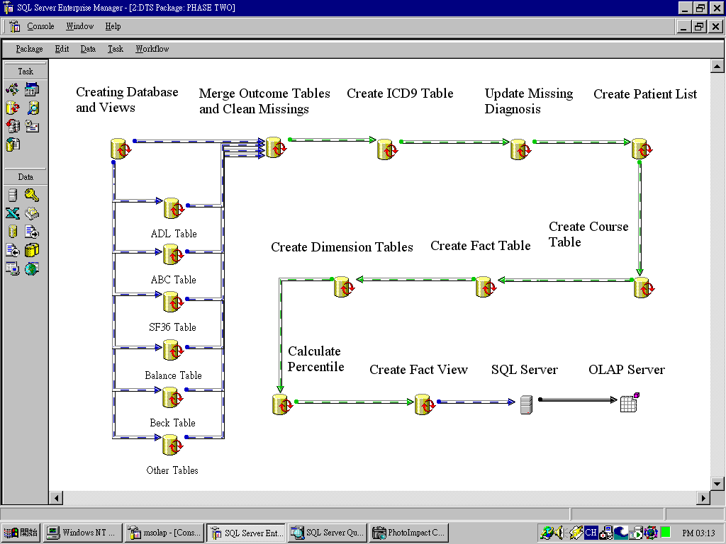

Slide 48
Output Example: Hierarchy of a dimension: drill-down and roll-up

Slide 49
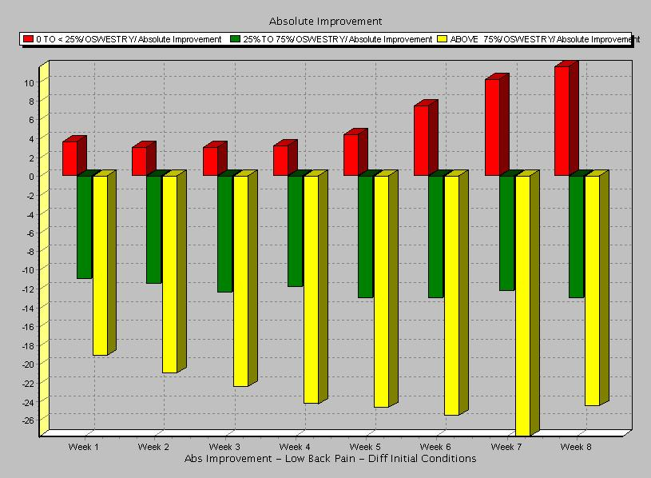
Power of a visual presentation

Slide 50
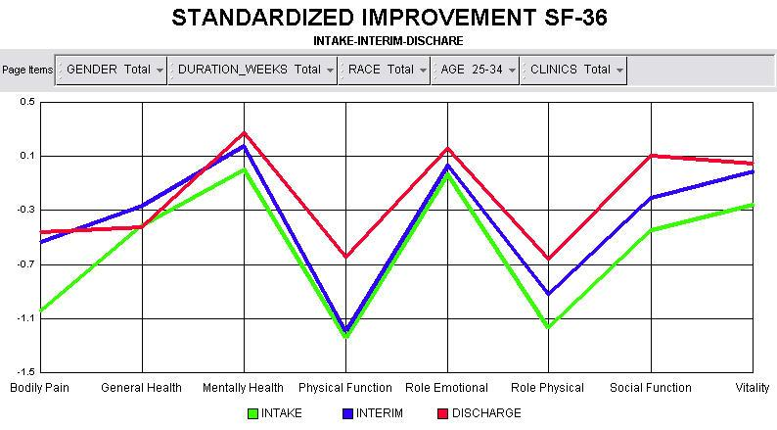
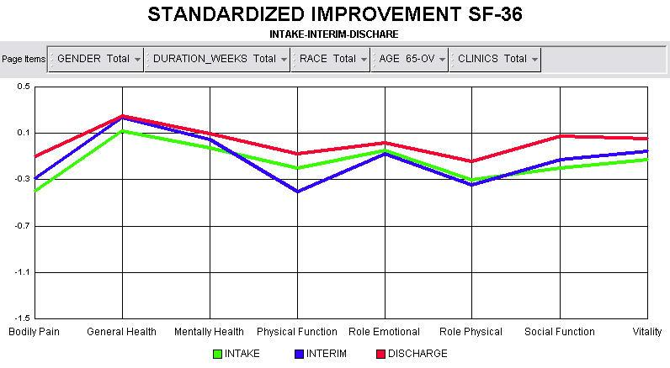
Difference in Improvement: Young and Old patients

Slide 51
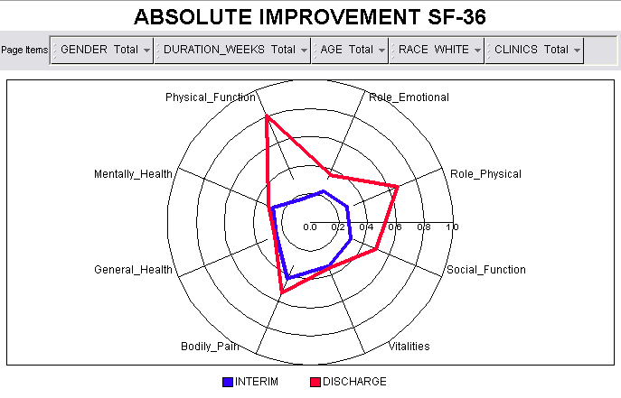
“radar” display

Slide 52
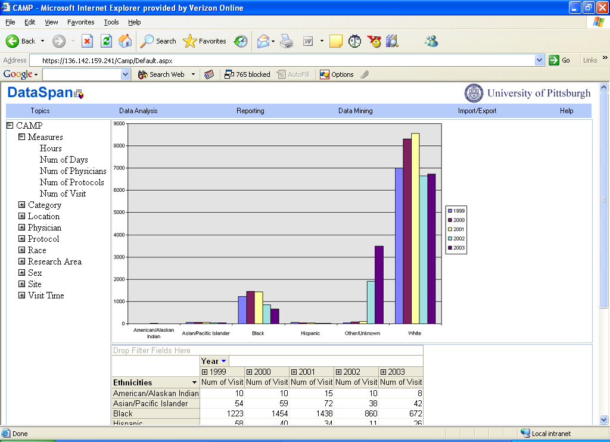
Application 2: Clinical Research Management

Slide 53
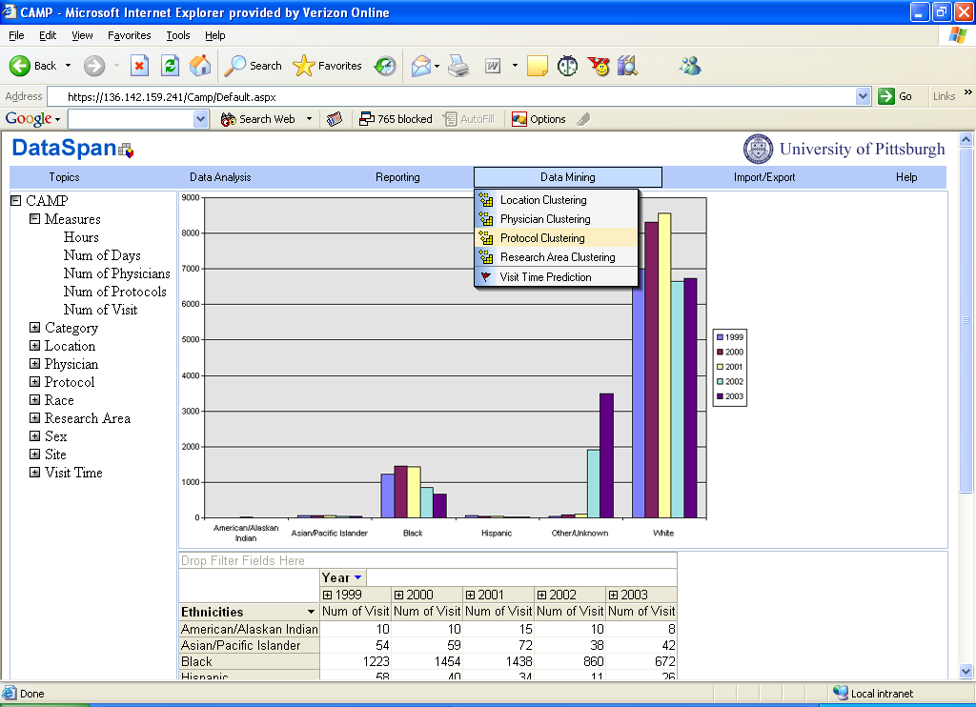

Slide 54
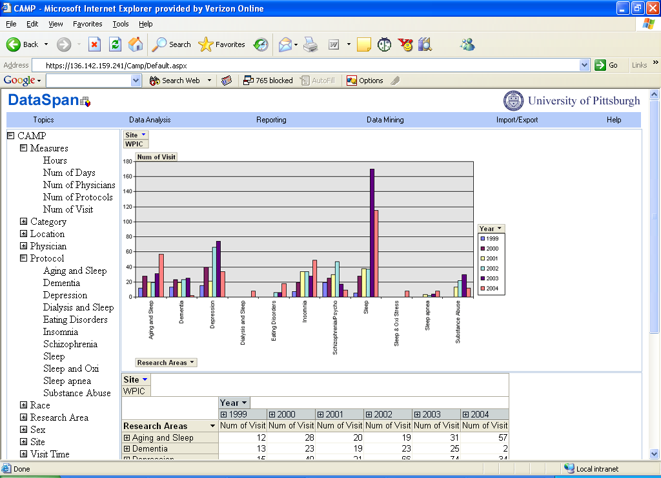

Slide 55
Application 3: Public Health
Combining Data Warehouse (OLAP) and GIS
OLAP: handles large data, fast retrieval multidimensional, multilevel aggregation, analyses/data mining on huge complex databases
GIS: visualization and spatial analyses
Visualization and Analysis: Charts and Maps + Statistical Analysis.

Slide 56
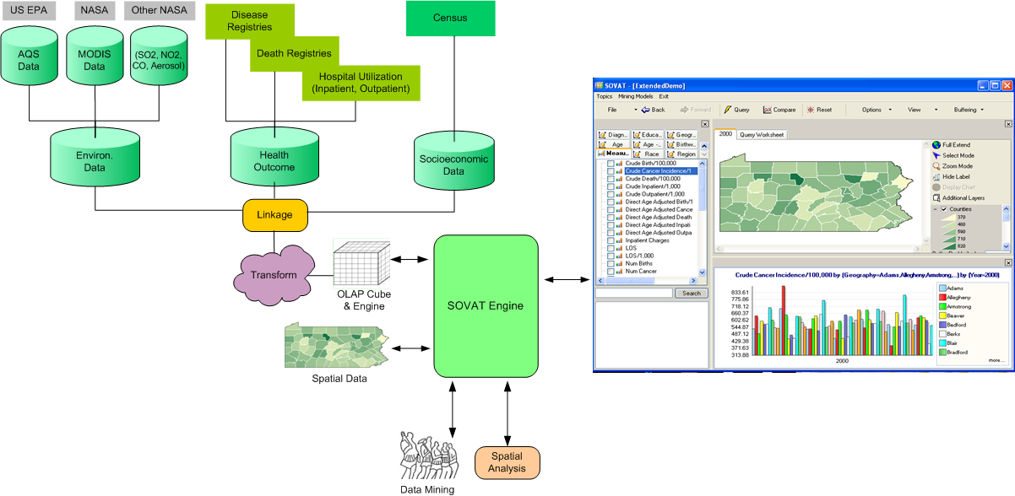
SOVAT (Spatial OLAP Viz and Analytical Tool)

Slide 57
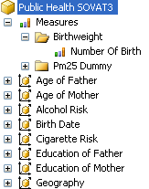
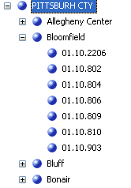
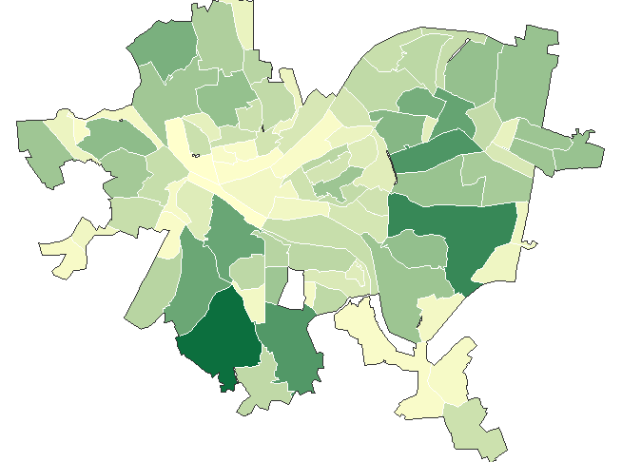
Linkage of OLAP Cube and spatial data
Cube
Geography Dimension

Slide 58
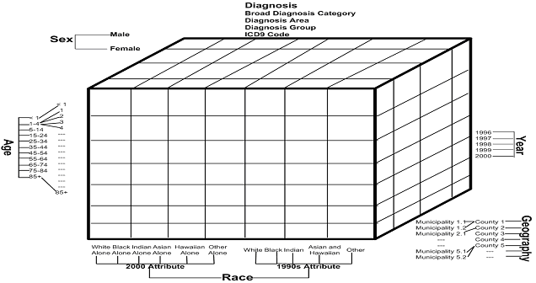
Multidimensional database
Functions: Drill-up/Drill-down, Slice/Dice, Pivot

Slide 59
Star Schema

Slide 60
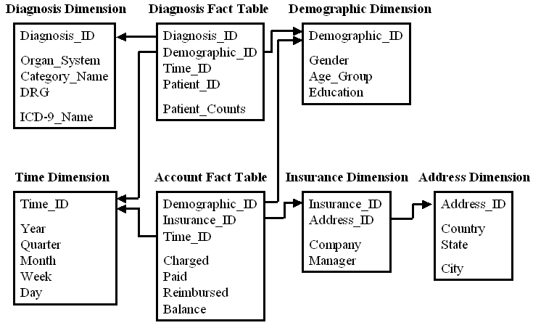
Snowflake schema

Slide 61
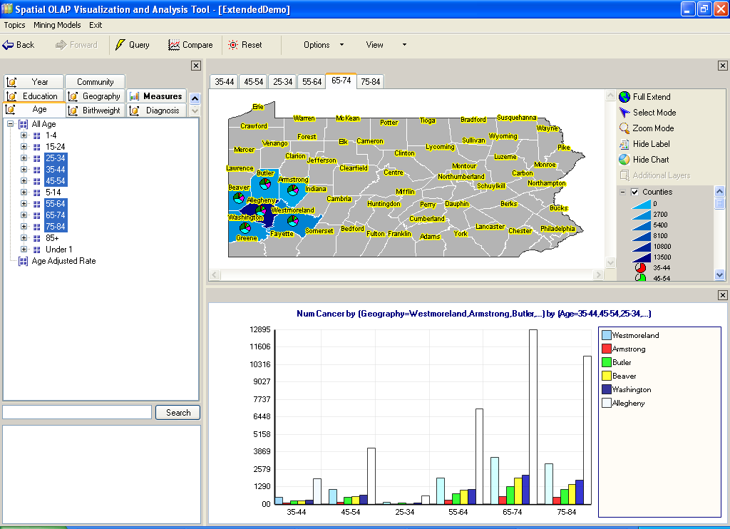
Spatial Drill-Up
Spatial Drill-Down
Spatial Drill-Out
Drag and Drop

Slide 62
Comparison and Border Analysis:
“Compare Allegheny County’s cancer incidence rate against it’s bordering counties.”

Slide 63
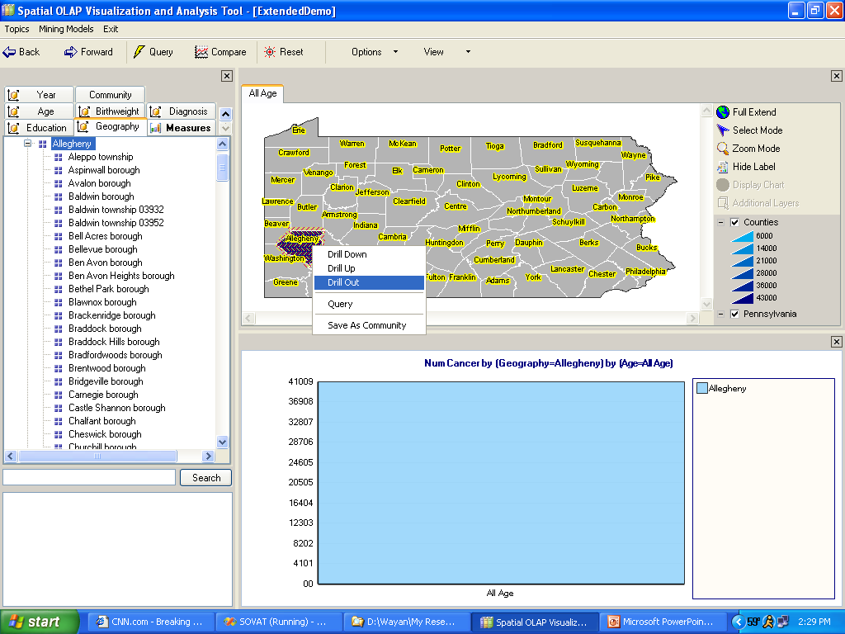

Slide 65
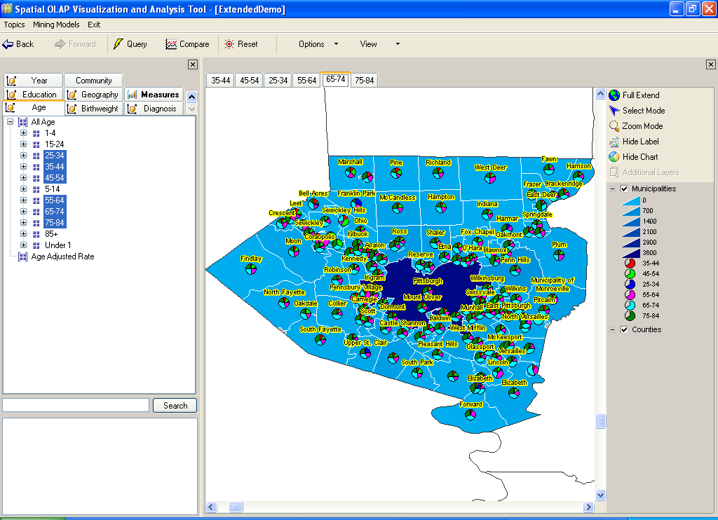

Slide 66
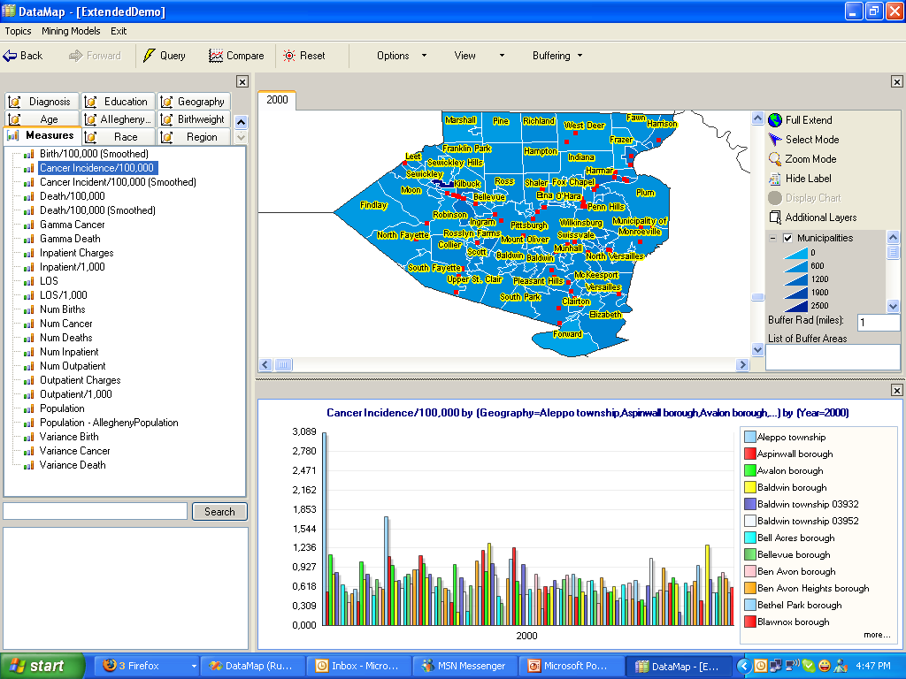

Slide 67
Ranking and sorting Massive data

Slide 68
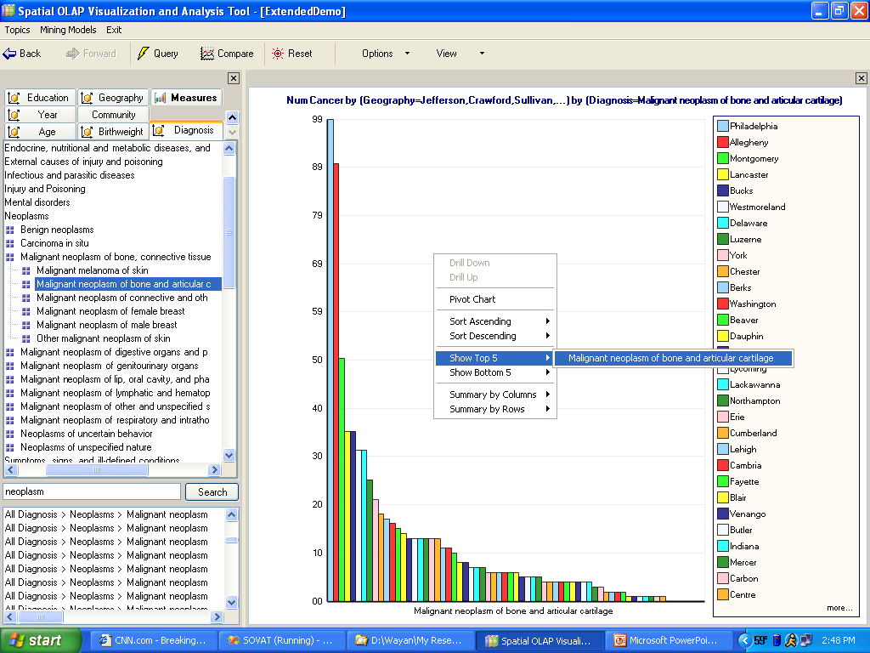

Slide 69
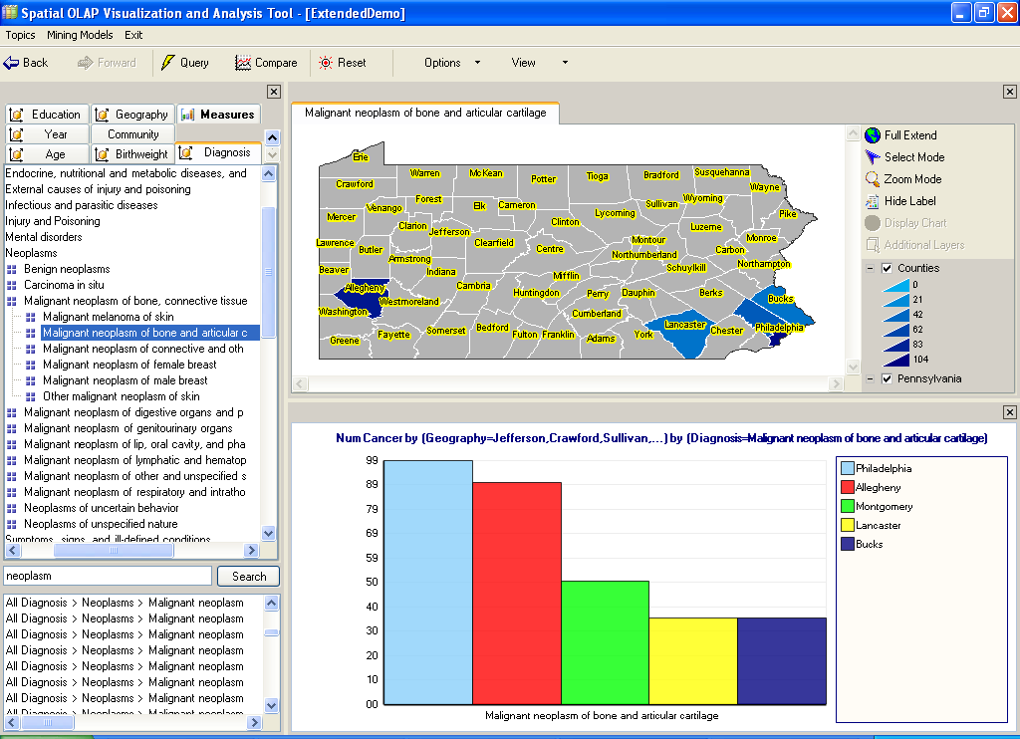

Slide 70
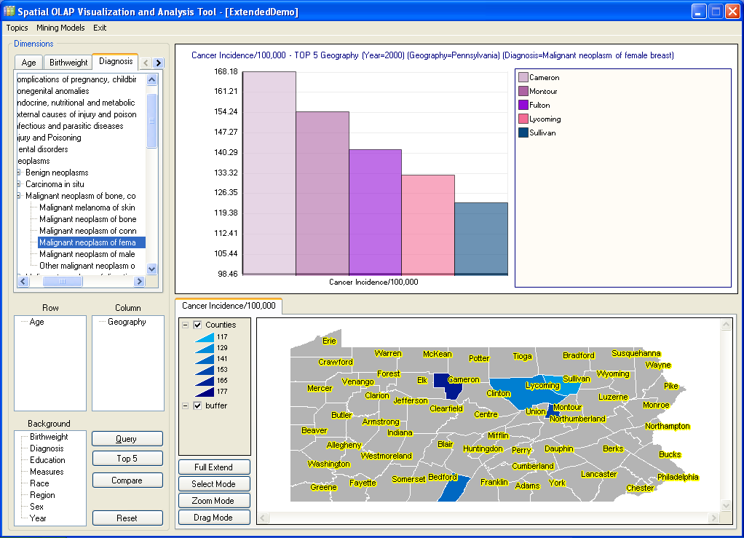

Slide 71
Comparing two arbitrarily defined communities:
“Compare the incidence/death rate/procedure related to certain cancer or specific diagnosis between the two metropolitans of Philadelphia and Pittsburgh”

Slide 72
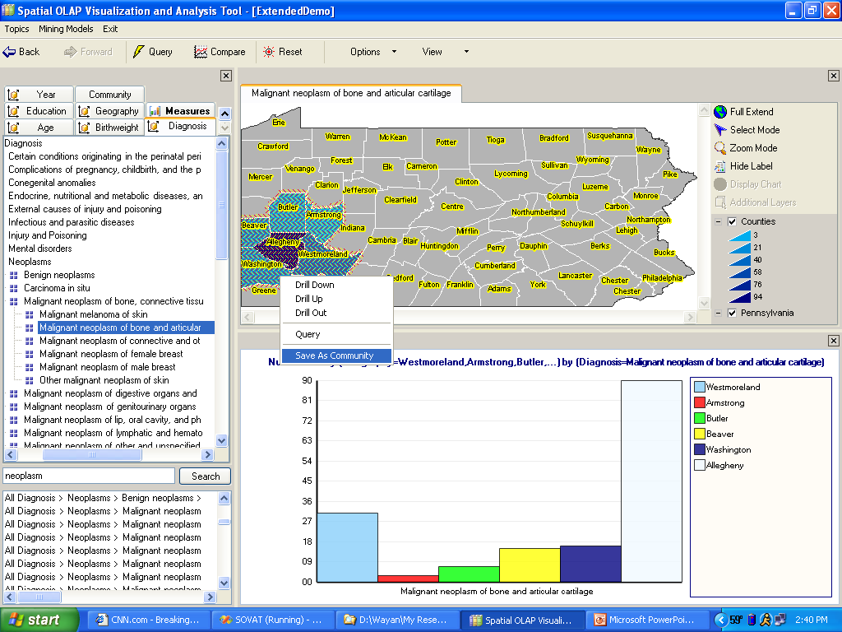

Slide 73
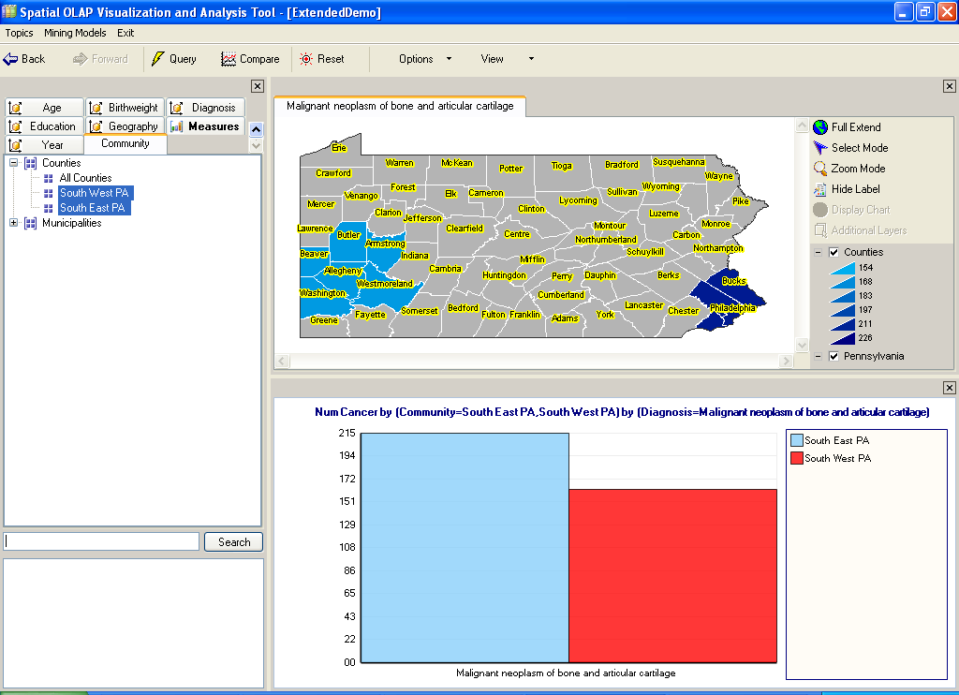

Slide 74


Slide 75
Time Series Example:
“Compare Cancer Incidence of Allegheny County to Erie County from 1996-2000”

Slide 76


Slide 77

Statistical Analysis

Slide 78
Red nodes shows toxic industrial places in Allegheny County

Slide 79

Buffer within 2.5 mile from CLEARWATER INC and the affected municipalities
Set the radius here
Buffer within
2.5 mile
List of affected municipalities

Slide 80


Slide 81



Authentication for accessing iSOVAT

Slide 82

Multidimensional view: cancer incidence in urban & rural areas

Slide 83

Drill-down Washington county

