Slide 1
Intro to Data Mining/Machine Learning Algorithms for Business Intelligence
Dr. Bambang Parmanto
Notes:
1

Slide 2
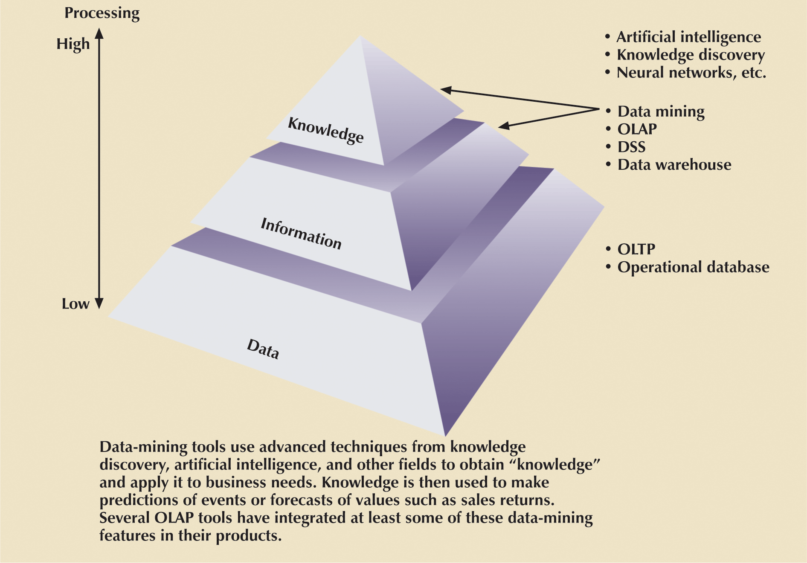
Extraction Of Knowledge From Data
Notes:
55

Slide 3
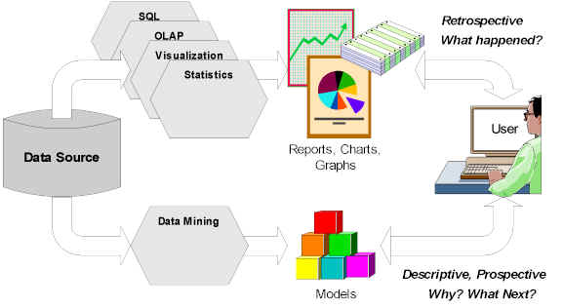
DSS Architecture: Learning and Predicting
Courtesy: Tim Graettinger

Slide 4
Data Mining: Definitions
Data mining = the process of discovering and modeling hidden pattern in a large volume of data
Related terms = knowledge discovery in database (KDD), intelligent data analysis (IDA), decision support system (DSS).
The pattern should be novel and useful. Example of trivial (not useful) pattern: “unemployed people don’t earn income from work”
The data mining process is data-driven and must be automatic and semi-automatic.

Slide 5
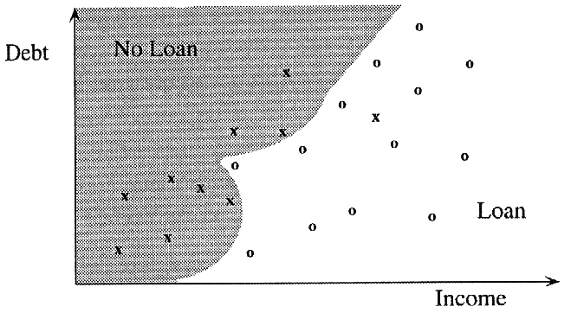
Example: Nonlinear Model

Slide 6
Basic Fields of Data Mining
Databases
Machine
Learning
Statistics

Slide 7
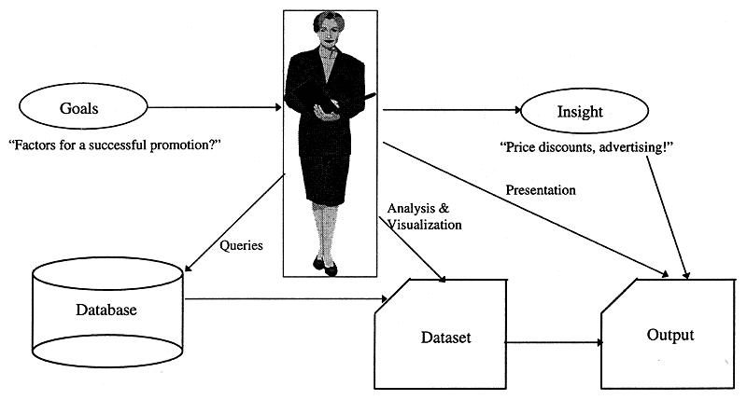
Human-Centered Process

Slide 8
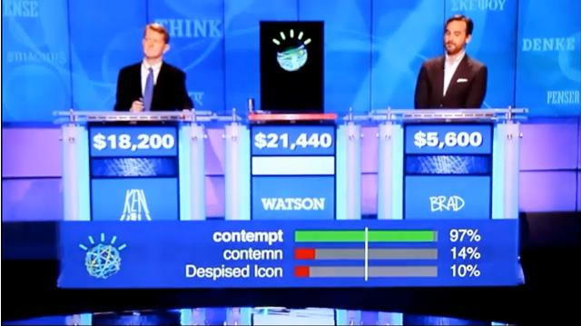
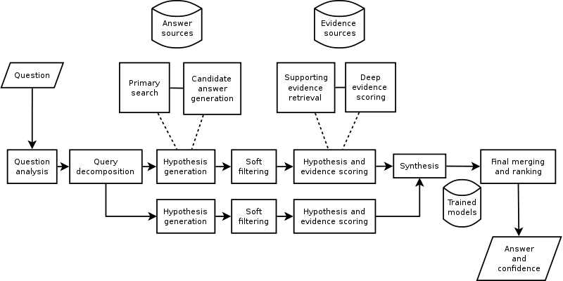
Watson Jeopardy

Slide 9
Core Algorithms in Data Mining
Supervised Learning:
  Classification
  Prediction
Unsupervised Learning
  Association Rules
  Clustering
  Data Reduction (Principal Component Analysis)
  Data Exploration and Visualization

Slide 10
Supervised Learning
Supervised: there are clear examples from the past cases that can be used to train (supervise) the machine.
Goal: predict a single “target” or “outcome” variable
Training data where target value is known
Score to data where value is not known
Methods: Classification and Prediction

Slide 11
Unsupervised Learning
Unsupervised: there is no clear examples to supervise the machine
Goal: segment data into meaningful segments; detect patterns
There is no target (outcome) variable to predict or classify
Methods: Association rules, data reduction & exploration, visualization

Slide 12
Example of Supervised Learning: Classification
Goal: predict categorical target (outcome) variable
Examples: Purchase/no purchase, fraud/no fraud, creditworthy/not creditworthy…
Each row is a case (customer, tax return, applicant)
Each column is a variable
Target variable is often binary (yes/no)

Slide 13
Example of Supervised Learning: Prediction
Goal: predict numerical target (outcome) variable
Examples: sales, revenue, performance
As in classification:
  Each row is a case (customer, tax return, applicant)
  Each column is a variable
Taken together, classification and prediction constitute “predictive analytics”

Slide 14
Example of Unsupervised Learning: Association Rules
Goal: produce rules that define “what goes with what”
Example: “If X was purchased, Y was also purchased”
Rows are transactions
Used in recommender systems – “Our records show you bought X, you may also like Y”
Also called “affinity analysis”

Slide 15
The Process of Data Mining

Slide 16
Steps in Data Mining
Define/understand purpose
Obtain data (may involve random sampling)
Explore, clean, pre-process data
Reduce the data; if supervised DM, partition it
Specify task (classification, clustering, etc.)
Choose the techniques (regression, CART, neural networks, etc.)
Iterative implementation and “tuning”
Assess results – compare models
Deploy best model

Slide 17
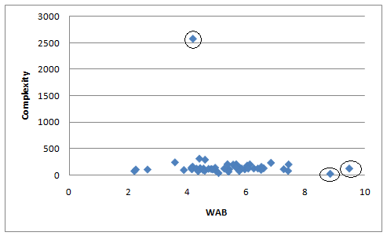
Preprocessing Data: Eliminating Outliers

Slide 18
Handling Missing Data
Most algorithms will not process records with missing values. Default is to drop those records.
Solution 1: Omission
  If a small number of records have missing values, can omit them
  If many records are missing values on a small set of variables, can drop those variables (or use proxies)
  If many records have missing values, omission is not practical
Solution 2: Imputation
  Replace missing values with reasonable substitutes
  Lets you keep the record and use the rest of its (non-missing) information

Slide 19
Common Problem: Overfitting
Statistical models can produce highly complex explanations of relationships between variables
The “fit” may be excellent
When used with new data, models of great complexity do not do so well.
Notes:
19

Slide 20
100% fit – not useful for new data
Consequence: Deployed model will not work as well as expected with completely new data.
Notes:
20

Slide 21
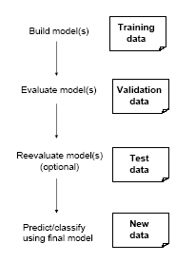
Learning and Testing
Problem: How well will our model perform with new data?
Solution: Separate data into two parts
  Training partition to develop the model
  Validation partition to implement the model and evaluate its performance on “new” data
Addresses the issue of overfitting

Slide 22
Algorithms:
for Classification/Prediction tasks
  k-Nearest Neighbor
  Naïve Bayes
  CART
  Discriminant Analysis
  Neural Networks
Unsupervised learning
  Association Rules
  Cluster Analysis

Slide 23
K-Nearest Neighbor: The idea
How to classify: Find the k closest records to the one to be classified, and let them “vote”.

Slide 24
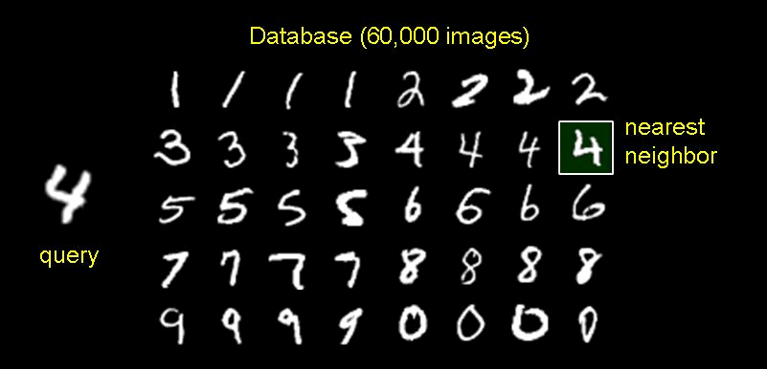
Example

Slide 25
Naïve Bayes: Basic Idea
Basic idea similar to k-nearest neighbor: To classify an observation, find all similar observations (in terms of predictors) in the training set
Uses only categorical predictors (numerical predictors can be binned)
Basic idea equivalent to looking at pivot tables

Slide 26
The “Primitive” Idea: Example
Y = personal loan acceptance (0/1)
Two predictors: CreditCard (0/1), Online (0,1)
What is the probability of acceptance for customers with CreditCard=1, Online=1?
50/(461+50) = .0978

Slide 27
Conditional Probability - Refresher
A = the event “customer accepts loan” (Loan=1)
B = the event “customer has credit card” (CC=1)
= probability of A given B (the conditional probability that A occurs given that B occurred)
If P(B)>0

Slide 28
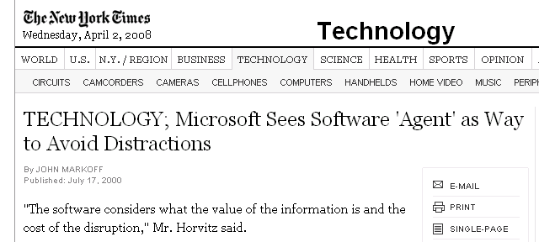

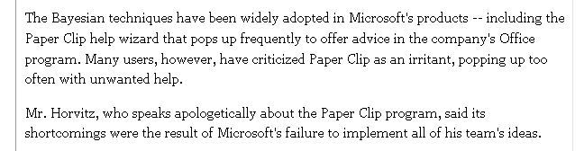
A classic: Microsoft’s Paperclip

Slide 29
Classification and Regression Trees (CART)
Trees and Rules
Goal: Classify or predict an outcome based on a set of predictors
The output is a set of rules
Example:
Goal: classify a record as “will accept credit card offer” or “will not accept”
Rule might be “IF (Income > 92.5) AND (Education < 1.5) AND (Family <= 2.5) THEN Class = 0 (nonacceptor)
Also called CART, Decision Trees, or just Trees
Rules are represented by tree diagrams

Slide 30
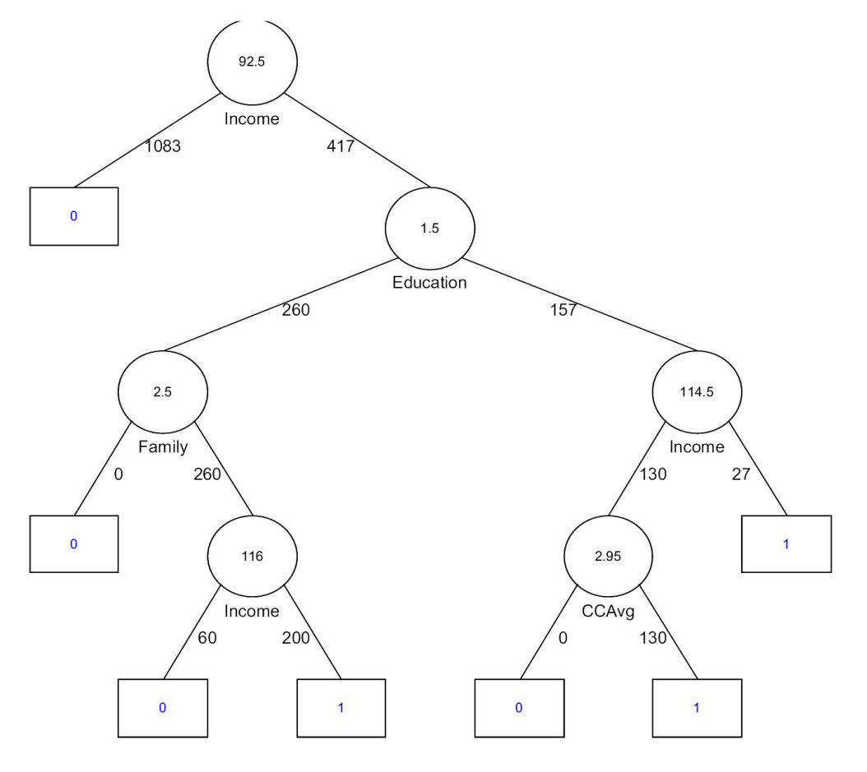

Slide 31
Key Ideas
Recursive partitioning: Repeatedly split the records into two parts so as to achieve maximum homogeneity within the new parts
Pruning the tree: Simplify the tree by pruning peripheral branches to avoid overfitting

Slide 32
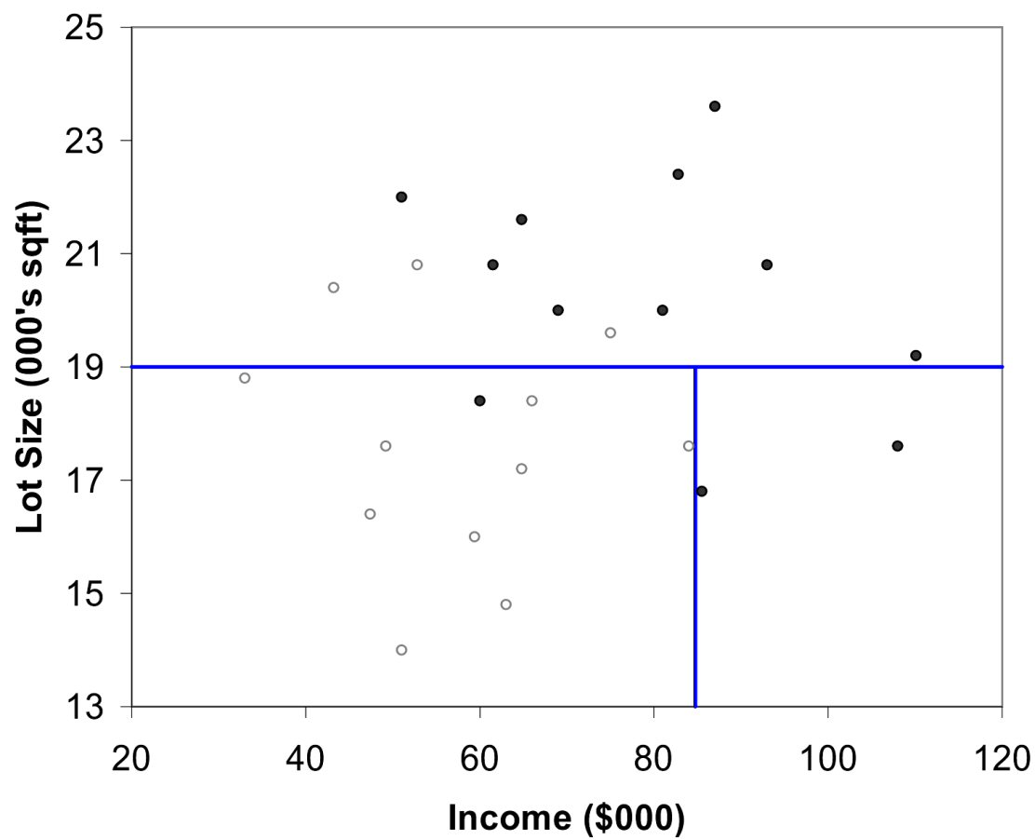
The first split: Lot Size = 19,000
Second Split: Income = $84,000

Slide 33
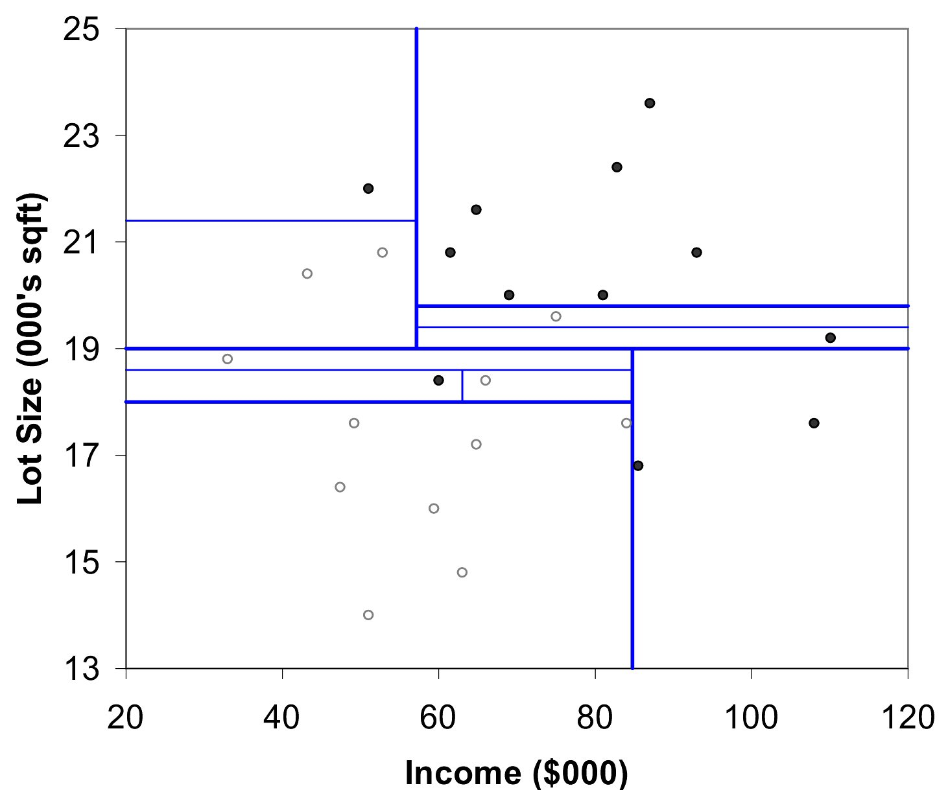
After All Splits

Slide 34
Neural Networks: Basic Idea
Combine input information in a complex & flexible neural net “model”
Model “coefficients” are continually tweaked in an iterative process
The network’s interim performance in classification and prediction informs successive tweaks

Slide 35
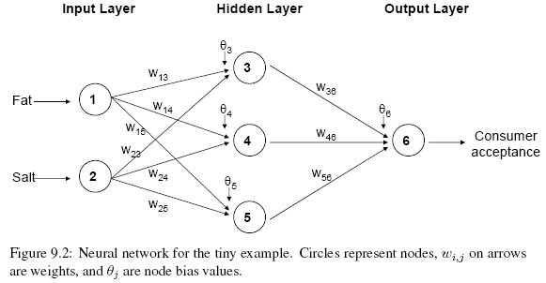
Architecture

Slide 36
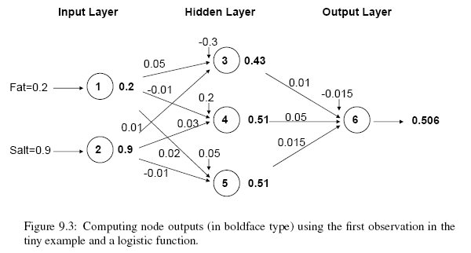

Slide 37
Discriminant Analysis
A classical statistical technique
Used for classification long before data mining
  Classifying organisms into species
  Classifying skulls
  Fingerprint analysis
And also used for business data mining (loans, customer types, etc.)
Can also be used to highlight aspects that distinguish classes (profiling)

Slide 38
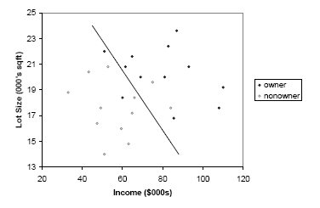
Can we manually draw a line that separates owners from non-owners?
LDA: To classify a new record, measure its distance from the center of each class
Then, classify the record to the closest class

Slide 39
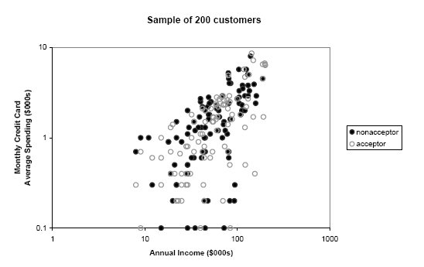
Loan Acceptance
In real world, there will be more records, more predictors, and less clear separation

Slide 40
Association Rules (market basket analysis)
Study of “what goes with what”
  “Customers who bought X also bought Y”
  What symptoms go with what diagnosis
Transaction-based or event-based
Also called “market basket analysis” and “affinity analysis”
Originated with study of customer transactions databases to determine associations among items purchased

Slide 41
Lore
A famous story about association rule mining is the "beer and diaper" story.
{diaper} > {beer}
An example of how unexpected association rules might be found from everyday data.
In 1992, Thomas Blischok of Teradata analyzed 1.2 million market baskets of 25 Osco Drug stores. The analysis "did discover that between 5:00 and 7:00 p.m. that consumers bought beer and diapers". Osco managers did NOT exploit the beer and diapers relationship by moving the products closer together on the shelves.

Slide 42
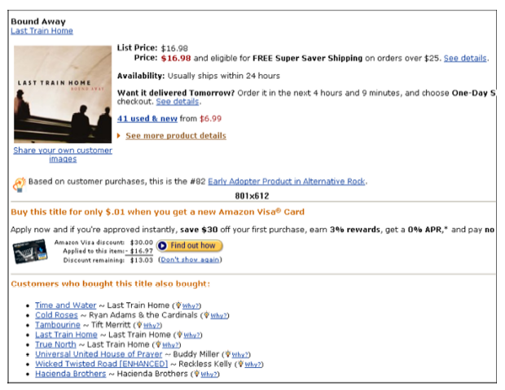
Used in many recommender systems

Slide 43
Terms
“IF” part = antecedent (item 1)
“THEN” part = consequent (item 2)
“Item set” = the items (e.g., products) comprising the antecedent or consequent
Antecedent and consequent are disjoint (i.e., have no items in common)
Confidence: Item 2 comes together with Item 1 in 10% of all transactions
Support: Item 1 comes together with Item 2 in X% of all transactions

Slide 44
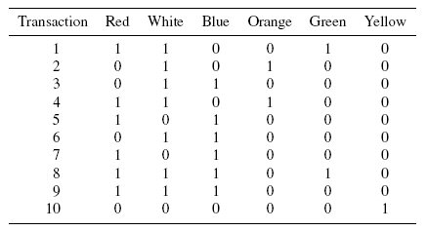
Plate color purchase

Slide 45
Lift ratio shows how important is the rule
  Lift = Support (a U c) / (Support (a) x Support (c) )
Confidence shows the rate at which consequents will be found (useful in learning costs of promotion)
Support measures overall impact

Slide 46
Application is not always easy
Wal-Mart knows that customers who buy Barbie dolls have a 60% likelihood of buying one of three types of candy bars.
What does Wal-Mart do with information like that? 'I don't have a clue,' says Wal-Mart's chief of merchandising, Lee Scott

Slide 47
Cluster Analysis
Goal: Form groups (clusters) of similar records
Used for segmenting markets into groups of similar customers
Example: Claritas segmented US neighborhoods based on demographics & income: “Furs & station wagons,” “Money & Brains”, …

Slide 48
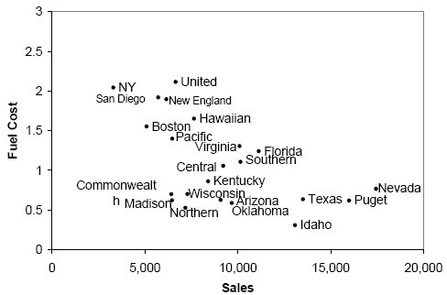
Example: Public Utilities
Goal: find clusters of similar utilities
Example of 3 rough clusters using 2 variables
High fuel cost, low sales
Low fuel cost, high sales
Low fuel cost, low sales

Slide 49
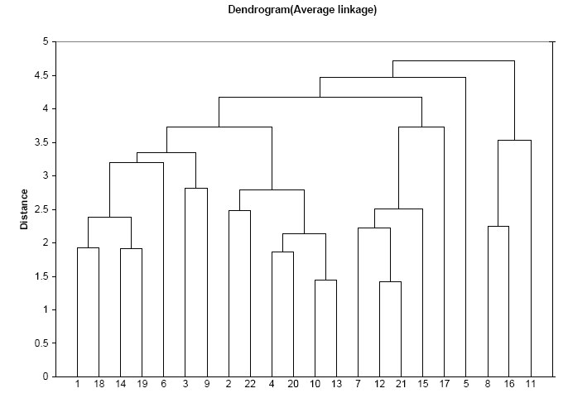
Hierarchical Cluster

Slide 50
Clustering
Cluster analysis is an exploratory tool. Useful only when it produces meaningful clusters
Hierarchical clustering gives visual representation of different levels of clustering
  On other hand, due to non-iterative nature, it can be unstable, can vary highly depending on settings, and is computationally expensive
Non-hierarchical is computationally cheap and more stable; requires user to set k
Can use both methods

