Slide 1
Genomics and Personalized Care
Leming Zhou, PhD
Assistant Professor
Department of Health Information Management
School of Health and Rehabilitation Sciences
University of Pittsburgh

Slide 2
Human Genome Project
1990 – 2003
Goals:
  identify all the approximately 20,000-25,000 genes in human DNA
  determine the sequences of the 3 billion chemical base pairs that make up human DNA
  store this information in databases
  improve tools for data analysis
  transfer related technologies to the private sector
  address the ethical, legal, and social issues (ELSI) that may arise from the project
http://www.ornl.gov/sci/techresources/Human_Genome/home.shtml

Slide 3
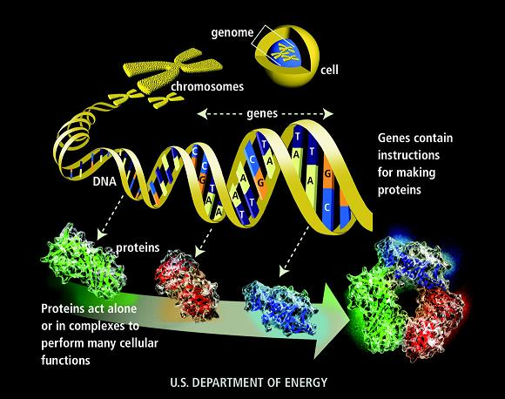

Slide 4
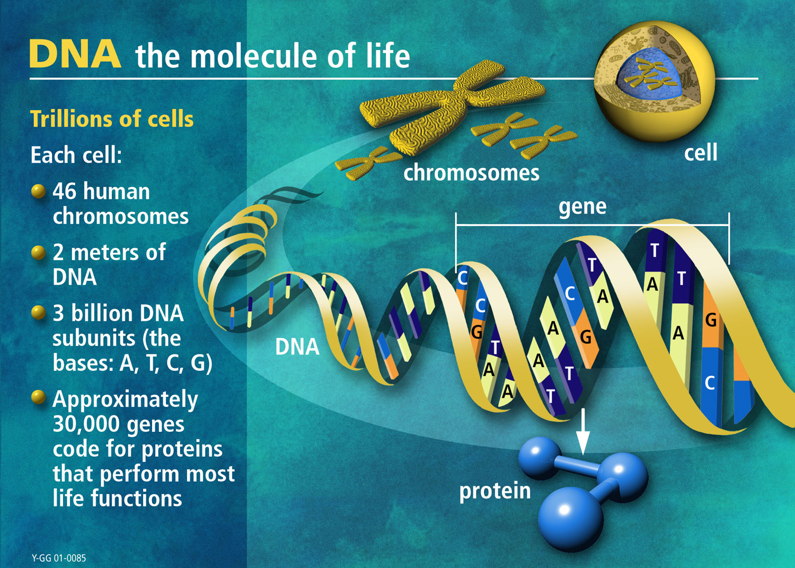

Slide 5
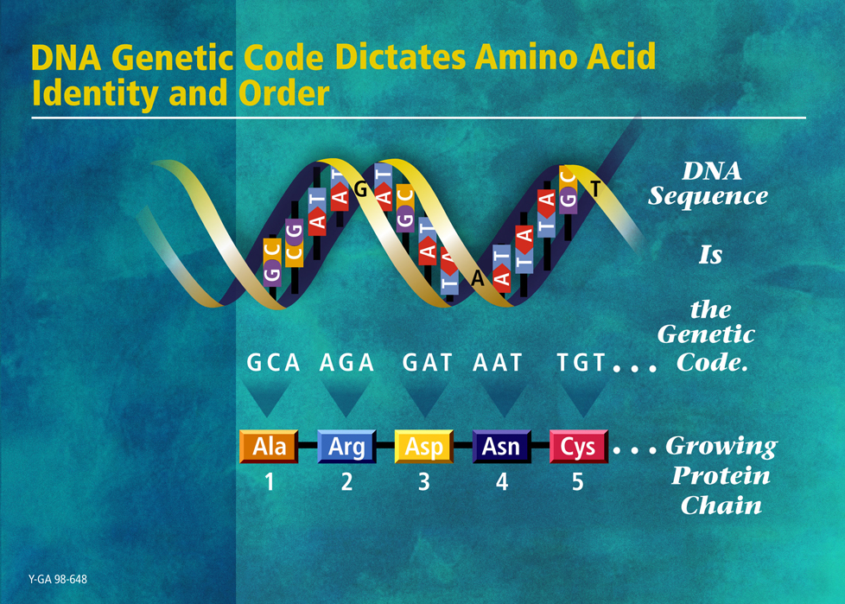

Slide 6
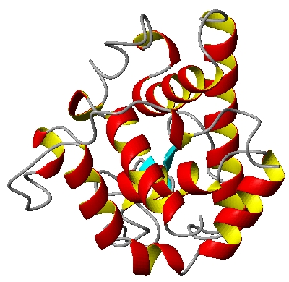
Eukaryotic Gene Organization
Gene: A stretch of DNA containing the information necessary for coding a protein / polypeptide / RNA
Promoter region
Translation start
transcription factor
binding sites
TATA box
Gene
DNA coding strand
Sp1
C/EBP
Oct1
Initiator
Transcription
cap
Exon 1
Exon 2
AAUAAA
Intron
(A)n
primary transcript
5’ UTR
GT
AG
3’ UTR
Splicing
ATG
TGA
5’ UTR
3’ UTR
mRNA
Translation
protein
(peptide)

Slide 7
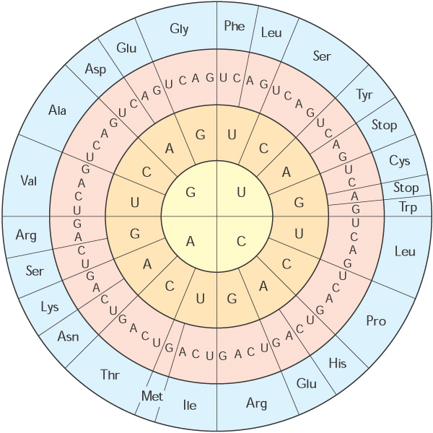
Protein
A molecule comprising a long chain of amino acids connected by peptide bonds
There are 20 standard amino acids encoded by the universal genetic code

Slide 8
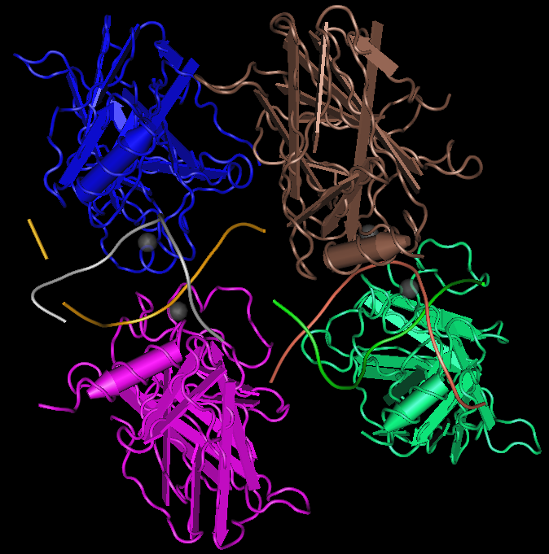
Protein 3D Structure
Protein structure is closely related to its biological function/activity
One protein may have multiple domains (structural or functional blocks) which may have functional interactions with different molecules
Human P53 core domain, MMDB ID: 69151, PDB ID: 3D0A

Slide 9
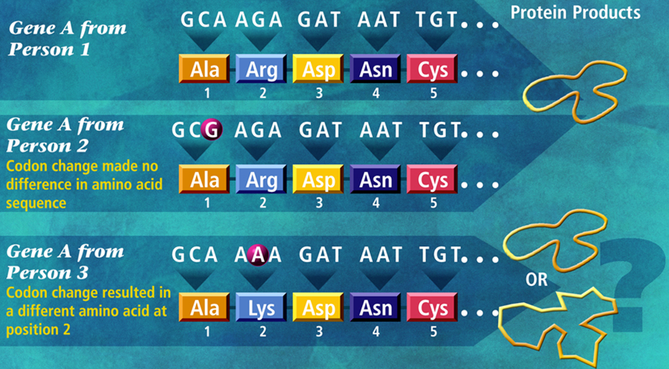
DNA Variations
DNA mutations
  Synonymous mutations:
    mutations do not lead to protein modification
  Non-synonymous mutation
    Mutations lead to protein modification

Slide 10
Genomics
Genomics is the study of the genomes of organisms.
Genomics involves large data sets (whole genome sequences) and high-throughput methods (DNA sequencing technologies)
  Genetics research focuses on one or a set of genes

Slide 11
DNA Sequencing Technologies
DNA sequencing: The process of determining the order of the nucleotide bases along a DNA strand
Technologies:
  Sanger method, 1977
    Used in Human Genome Project
    Slow, and expensive ($300m/genome)
  Whole Genome Shotgun sequencing (1990s)
    Break the genome into short pieces
    Sequence all the pieces in parallel
    Put all the pieces back together (sequence assembly)
    Faster and cheaper (~$10m/genome)
  Next generation sequencing technologies (2000s)
    Much faster speed & lower cost (<$5k/genome,2009)
  Third generation sequencing technologies (after 2009)
    Nanopore, single molecule real time sequencing

Slide 12
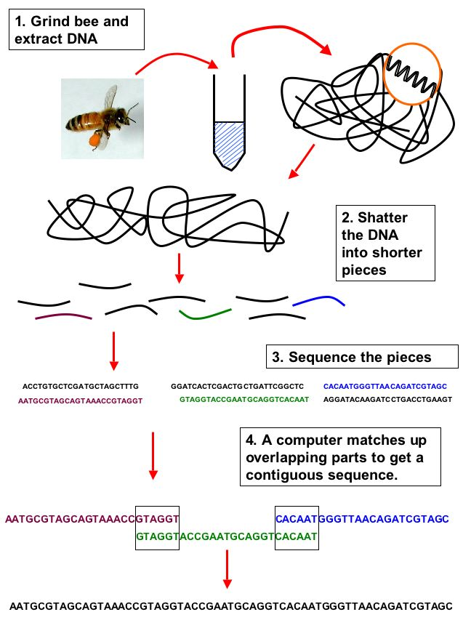
Whole Genome Shotgun Sequencing
http://beespotter.mste.uiuc.edu/topics/genome/Honey%20bee%20genome.html

Slide 13
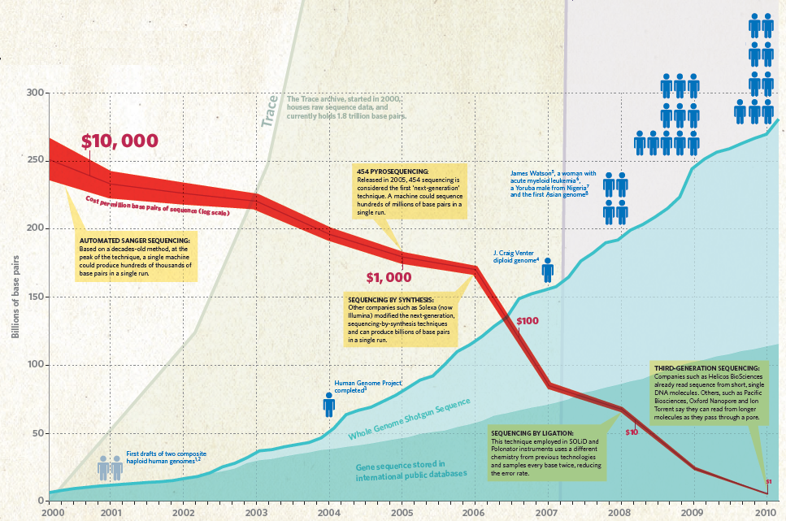
http://www.nature.com/news/2010/100331/full/464670a.html

Slide 14
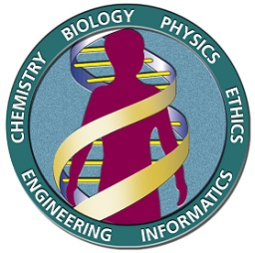
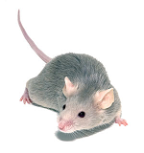
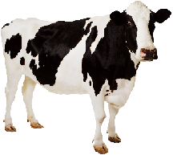
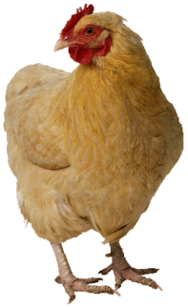

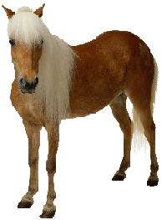
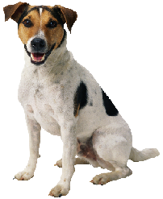
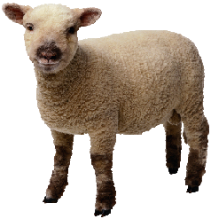
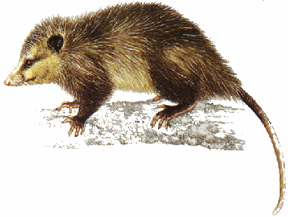
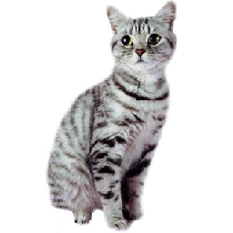
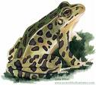

Genome Sequences
Species | Complete | Draft Assembly (Almost complete) | In process | Total
All | 807 | 808 | 817 | 2432
Eukaryotes | 37 | 240 | 266 | 543
http://www.ncbi.nlm.nih.gov/genomes/static/gpstat.html
Retrieved on 7/14/2010

Slide 15
Genome Sequence Sizes
DNA Sequence size is measured as base pairs
HIV virus 9,193
Haemophilus influenzae 1,830,000
E. coli 4,600,000
Yeast 12,500,000
Fruit fly 180,000,000
Human 3,000,000,000

Slide 16
GeneBank Release 178.0
June 15 2010
ftp://ftp.ncbi.nih.gov/genbank/
Nucleotide sequence database
Full release every two months
Incremental and cumulative updates daily
Release 178.0 (6/15/2010)
120,604,423 Sequences
115,624,497,715 Bases

Slide 17
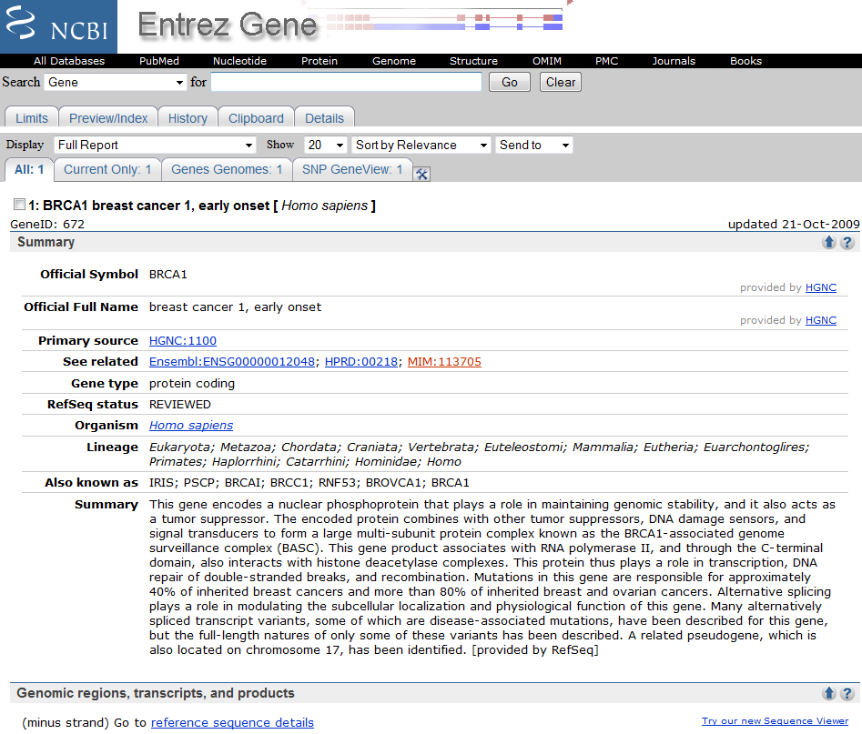
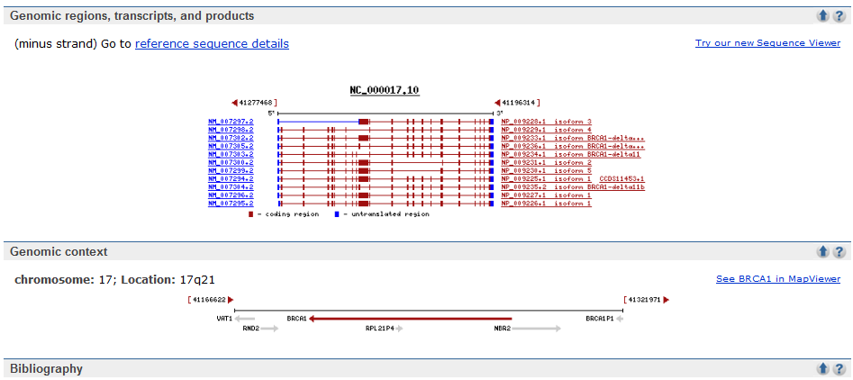

Slide 18
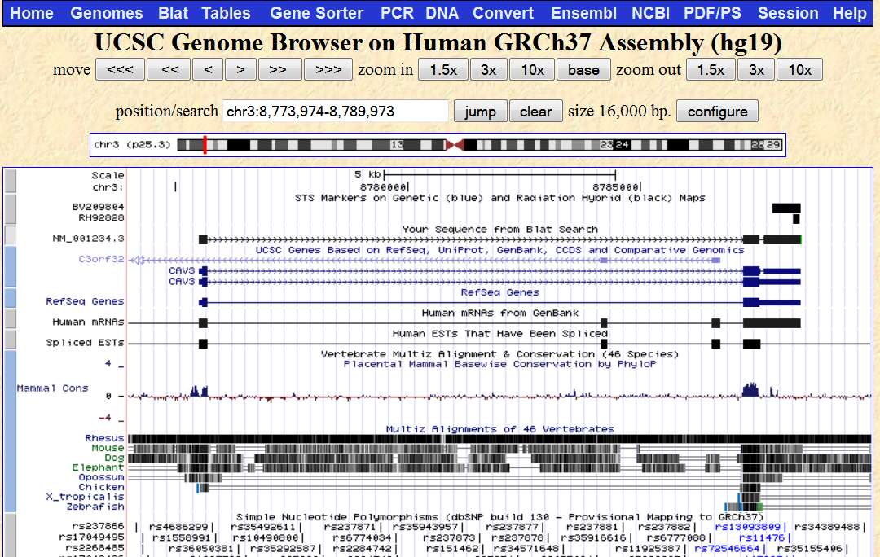
UCSC Genome Browser

Slide 19
Why Do People Look Different?
Genetic variation
  Eye color - common genetic variation
  Down’s syndrome - rare genetic variation
Environment:
  Diet
  Exercise
Genes and gene products interact with their molecular environments

Slide 20
Disease: Consequence of Variation
Genetic variation is responsible for the adaptive changes that underlie evolution.
Some changes improve the fitness of a species. Other changes are maladaptive.
For the individual in a species, these maladaptive changes represent disease.

Slide 21
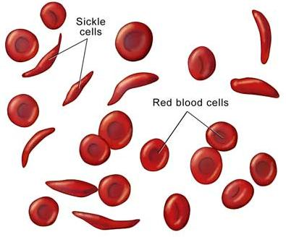
Sickle Cell Anemia
Sickle cell anemia is an example of a single gene disorder.
It is caused by mutations in β globin (HBB).
There is a common point (E6V) mutation.
This mutation causes hemoglobin molecules to aggregate, giving red blood cells a sickled appearance.
http://www.biologycorner.com/anatomy/blood/notes_blood_disorders.html
Sickle cell animia, http://www.youtube.com/watch?v=9UpwV1tdxcs

Slide 22
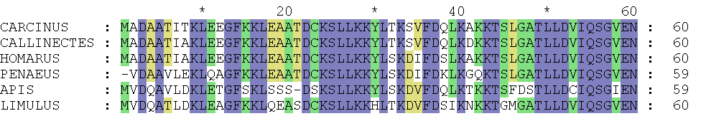
Disease Diversity
Many regions of the genome may be affected
There are many mechanisms of mutation
An individual interacts with the environment in ways that may promote disease
Complex diseases: common disorders that have many causes
  Alzheimer, diabetes, obesity, cancer, etc.
http://home.bbioo.com/attachment/200903/17/23896_1237271095upkP.gif

Slide 23
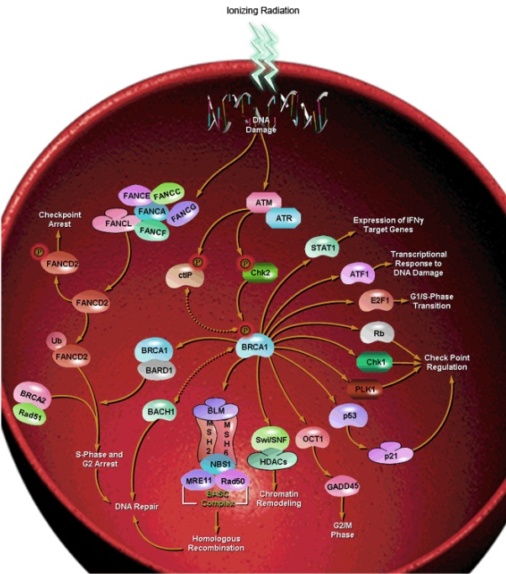
Biological Pathway
http://www.sabiosciences.com/

Slide 24
Genetic Variation, Environment, and Disease
Lead poisoning is an environmental disease
Two children exposed to the same dose of lead may have entirely different responses.
This susceptibility has a genetic basis.
Genes affect susceptibility to environmental insults, and infectious disease.

Slide 25
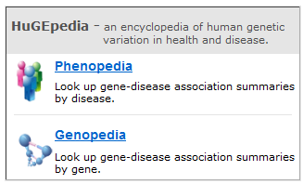
Genopedia and Phenopedia

Slide 26
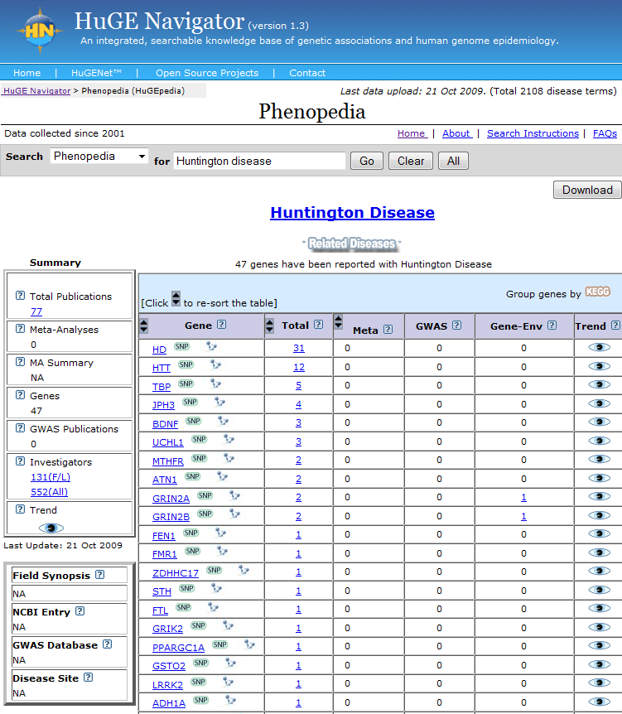
Finding Disease Causing Genes

Slide 27
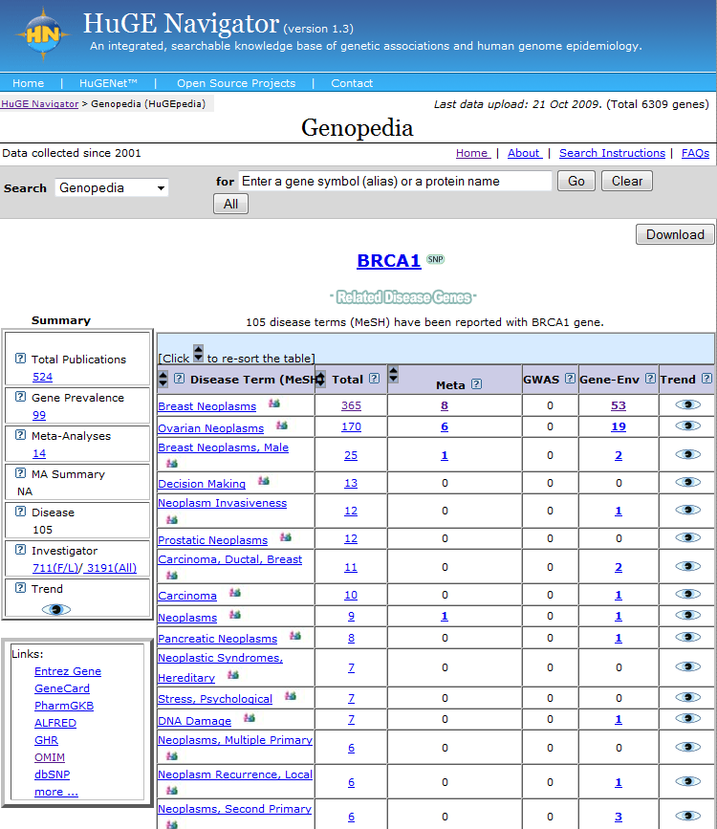
Finding Gene’s Associated Diseases

Slide 28
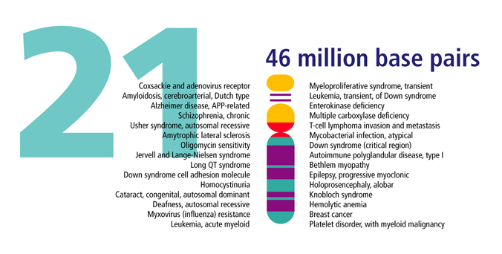
Genome Sequences and Diseases
http://genomics.energy.gov

Slide 29
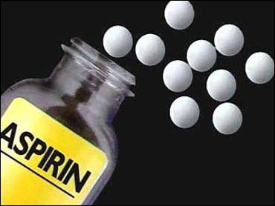
Drugs have Different Effects on Patients
Example: Aspirin
Effective to avoid thrombosis for some patients
Not effective for a number of patients
Benefits: pain relief, prevents heart attacks
Side effects: bleeding

Slide 30
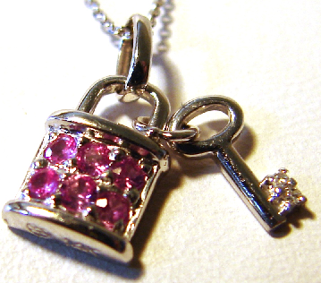
Drug Receptor
A key must fit into the lock to open a door
Drugs (key) bind drug receptors (lock) on cells to cause effects
Genetic variation can cause variation in drug receptors and therefore different people have different drug responses

Slide 31
Today’s Medical Practice
Three persons of the same height, weight, and age have the same symptom and go to a doctor. The doctor prescribes the same drug at the same dose.
  Person A has an adverse drug reaction (ADR, unwanted negative reaction)
  Person B nothing happens
  Person C gets better
There are multiple causes for ADRs
  Some ADRs have a genetic basis
  Some ADRs may have an environmental basis
Poor metabolizers (because of genetic variation) can experience ADRs at normally therapeutic drug doses

Slide 32
What Do We Do?
Person A has an adverse reaction
  Reduce dose or change drug
Person B nothing happens
  Increase dose or change drug
Person C gets better

Slide 33
Today: One-size-fits-all drugs
Current drug development system develops drugs for the “average” patient
  Results from large scale clinical trials
No simple way to determine who will respond well and who will respond poorly
One size does NOT fit all!
What’s the solution?

Slide 34
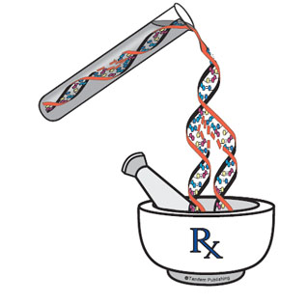
Pharmacogenomics
Pharmacogenomics is the study of how an individual's genetic inheritance affects the body's response to drugs.
Pharma = drug or medicine
Genomics = the study of gene
Personalized medicine tailored to your genes

Slide 35
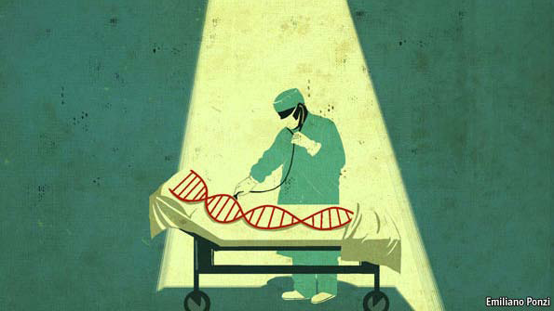
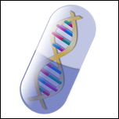
Future: Personalized Care
You feel terrible, and you go and see a doctor.
The physician looks you over, check you medical history, listens to your symptoms, take a look at your genome, and decides to prescribe you a drug specific for you (right drug and dose).
  Personalized drug is more effective & minimizes side effects
http://www.economist.com/node/16349422/
http://www.prweb.com/releases/2005/12/prweb318956.htm

Slide 36
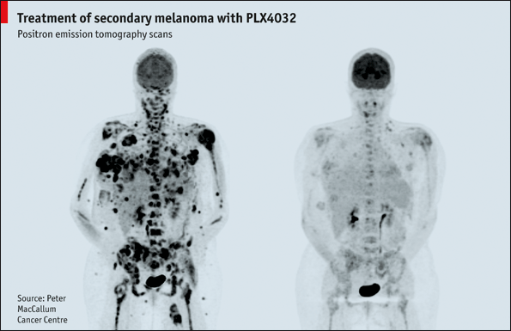
Treating Cancer with Personalized Drug
The two photographs below show the same individual before and after treatment with a molecule code-named PLX4032.
The shadows are tumors from secondary melanoma, one of the most aggressive cancers known.
PLX4032 cleared them almost completely. It was designed specifically to interact with the protein produced by a particular mutated version of a gene called B-RAF.
http://www.economist.com/node/16349422/

