Slide 1
Agenda
Data Storage
Steganography
Phishing

Slide 2
Data Storage

Slide 3
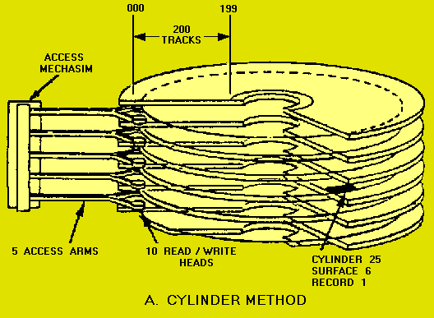
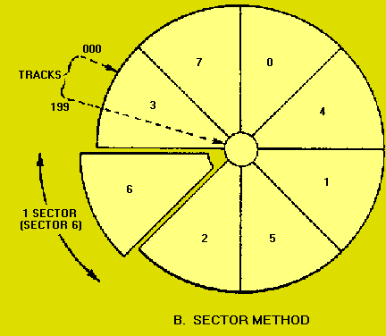
Data Storage
How are files stored?
  Each file is assigned one or more sectors in the disk.
  If the file is small enough, not all the sector will be used.
  The unused space is called a Slack space
  We can save information there using a special editor.

Slide 4

Data Storage
How do you know that the data you stored hasn’t been modified?
  Hash functions
What is a hash function?
  Is a function with an special algorithm that finds a value given a file.
  Each file has a unique hash value.
  Even small changes in a file can generate totally different hash values.

Slide 5
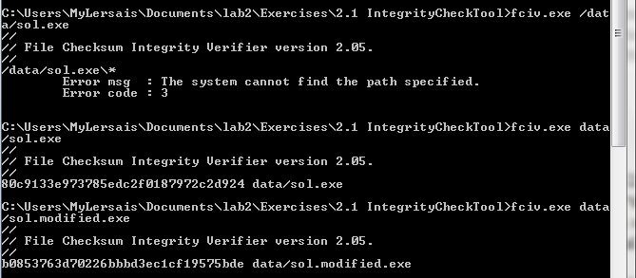
Let’s try it…
First get the hash values:
Hash value
original file
Hash value
modified file

Slide 6
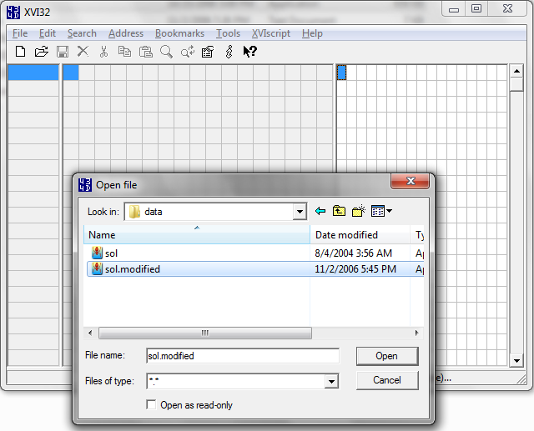
Let’s try it…
Now let’s open the modified file:

Slide 7
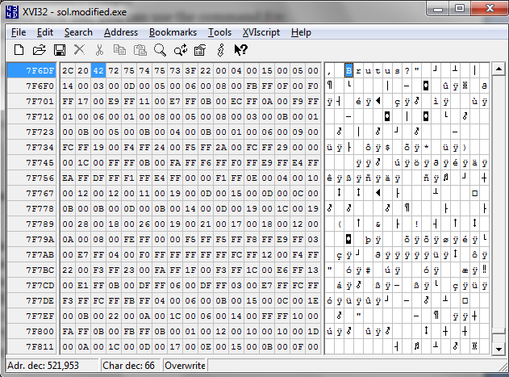
Let’s try it…
Entire phrase:

Slide 8
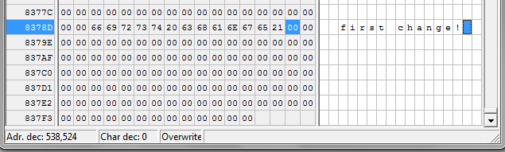
Let’s try it…
Try to make other changes (possibly random) to the file and save the file with another name, but retaining the extension.
Can you execute the new file? Explain why or why not?
Close all windows.
☺
☹

Slide 9
Steganography

Slide 10


Can you tell the difference?
Can you tell which one is the original?

Slide 11
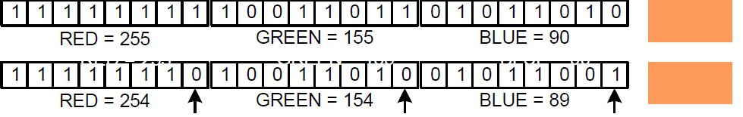
How does it work?
Each byte represents a shade red, blue or green.
  Random changes to the least priority bit generally produce only slight changes of shade
Resulting
Shade

Slide 12
Let’s try it!
Go to desktop/Exercises/3.0 Steganography/
Double-click on the “Jphswin.exe”
Hide data into “jpeg” file.
  Click on Open Jpeg on the menu bar and open the file “KaalBhairava.jpg” in “data” sub-folder.
  Create a text file “input.txt” with some text in the “data” folder.
  Click on Hide on the menu bar and give a password of your choice as prompted. Then, as prompted, point to the file “input.txt” that you intend to hide.
  Lastly, use save jpge as to save the image as “hidden.jpg” in the “data” sub-folder. The message text in “input.txt” has been hidden in the jpeg image file “hidden.jpg”.

Slide 13
Let’s try it!
Close all open files and the JPHS application.
Retrieve the hidden message from the “jpeg” file.
  Open the file “hidden.jpg” using the Steganography tool “Jphswin.exe”.
  Click on Seek on the menu bar. Then, as prompted, save the file as hidden “output.txt” into the “data” folder.

Slide 14
So what is Steganography
  Hide messages in such a way that no one, apart from the sender and intended recipient, suspects the existence of the message, a form of
  Security through obscurity
What other types of files can be used?
  Documents, images, audio files… Hide relatively small amount of data in other data files that are significantly larger
What is it useful for?
  Send secret messages
  Watermarking products for proprietary issues

Slide 15
Final example…
PRESIDENT'S EMBARGO RULING SHOULD HAVE IMMEDIATE NOTICE. GRAVE SITUATION AFFECTING INTERNATIONAL LAW. STATEMENT FORESHADOWS RUIN OF MANY NEUTRALS. YELLOW JOURNALS UNIFYING NATIONAL EXCITEMENT IMMENSELY.
Can you find the hidden message?
  PERSHING SAILS FROM NY JUNE I.

Slide 16
Example of Steganography (Text – page 48)
Dear George,
Greetings to all at Oxford. Many thanks for your
letter and for the summer examination package.
All entry forms and fees forms should be ready
for final dispatch to the syndicate by Friday
20th or at the latest I am told by the 21st.
Admin has improved here though there is room
for improvement still; just give us all two or three
more years and we will really show you! Please
don’t let these wretched 16+ proposals destroy
your basic O and A pattern. Certainly this
sort of change, if implemented immediately,
would bring chaos.
Sincerely yours,
your
package
ready
Friday
21st.
room
three
Please
destroy
this
immediately

Slide 17
Let’s go phishing

Slide 18
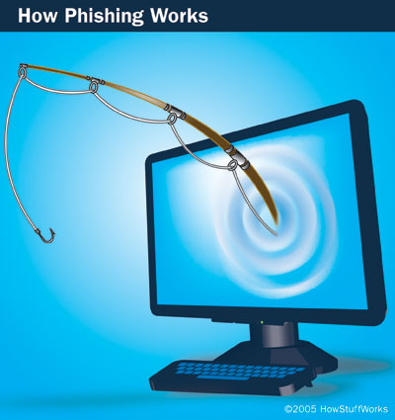
Let’s see how it works…
Please go to:
  http://wombatsecurity.com/antiphishing_phil/index.html

Slide 19
So what is phishing?
“Phishing e-mail messages are designed to steal your identity. They ask for personal data, or direct you to Web sites or phone numbers to call where they ask you to provide personal data” [1].
Steps:
  Gain your trust
  Ask for personal information

Slide 20
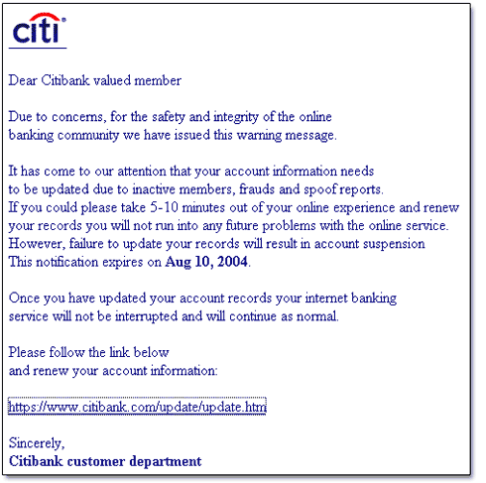
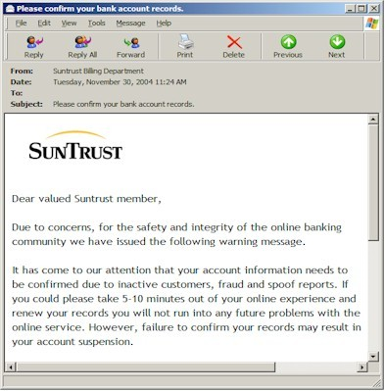
How they gain your trust?
Logos that look real
They may use information learnt in social networks
They may seem to come from someone you trust

Slide 21
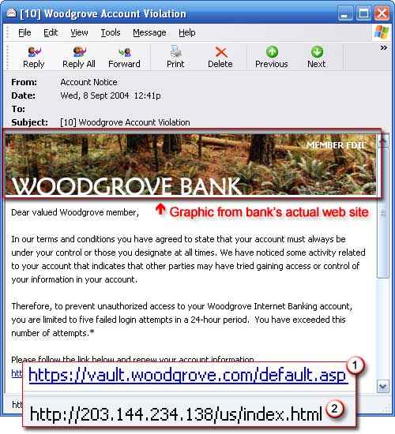

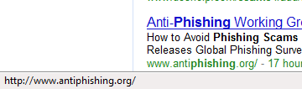
Even if an URL looks fine…
In Firefox if you step over the address,
you’ll see the real URL. Like here:

Slide 22
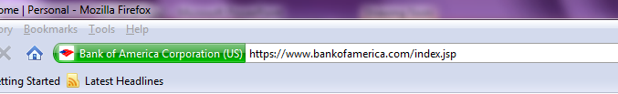
Other clues…
If the web page is trusted by your browser, you’ll see something like this:
  Firefox:
  In Internet Explorer:
Are these two fine?
    https://www.bankofamerica.com/index.jsp
    https://www.bank○famerica.com/index.jsp

Slide 23
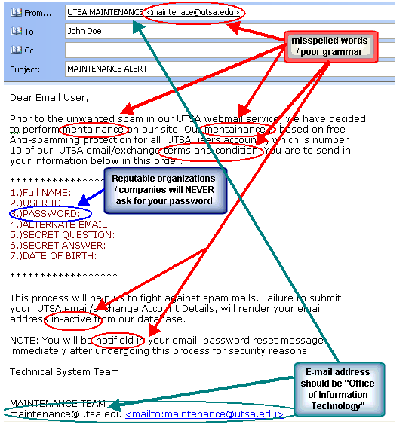
Other clues…

Slide 24
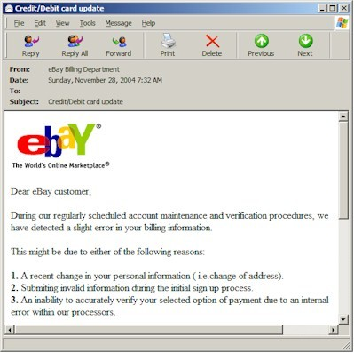
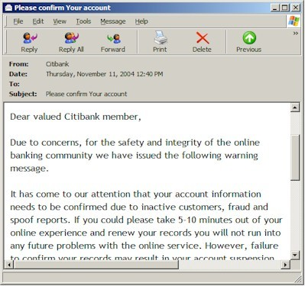
More examples

Slide 25
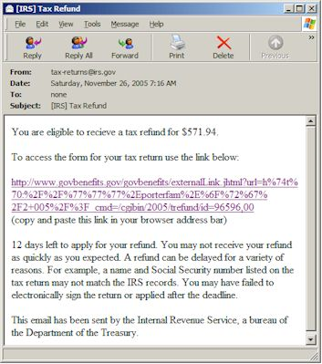
More examples

Slide 26

Cookies

Slide 27
Cookies
What are browsing cookies?
  HTTP is stateless
    Each HTTP request and response are treated in isolation
    Hard for web servers to determine their state with the client they are serving
  Cookies are used to maintain state information
    Authentication
    Session tracking
    Storing site preferences
    Shopping cart contents
    Identifier for a server-based session

Slide 28
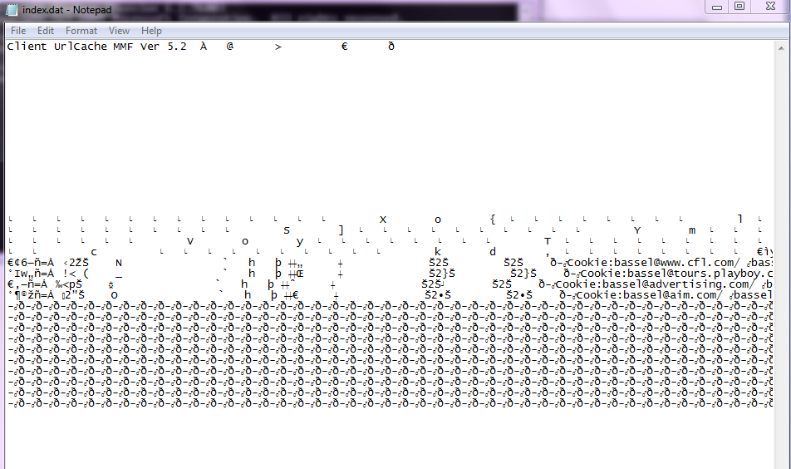
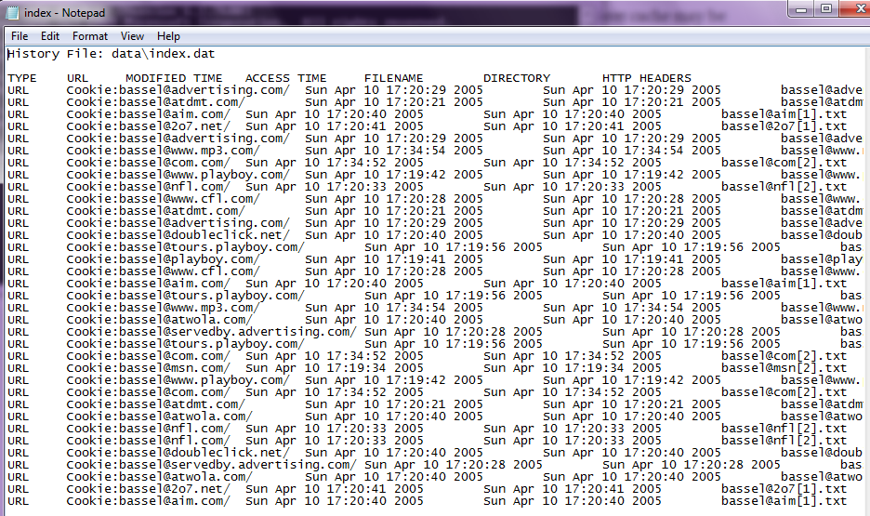
Hands on…
Now you can see what the owner was looking at:
TYPE URL MODIFIED TIME ACCESS TIME FILENAME DIRECTORY HTTP HEADERS

Slide 29

Decrypt the cookie

Slide 30
Can you think of any threat?
  Cookies can be used as spyware
    Track internet users' web browsing habits
      Web pages visited
      Order Time

Slide 31
Have you hear about Web Bugs?
  A small graphic on a web page that allows sites to track user activities
  How they work?
    Typically 1 pixel X 1 Pixel images that cannot be seen
    The image is loaded by a page from Site X
    The image itself comes from Site Y
    Site X and Site Y now have exchanged information about the user’s web activities
    E.g. : “Alice has visited msnbc.com and has gone to the sports page” ---> SupplyAds.com ----> Ad for NBA gear
  Use tools like Bugnosis for IE to detect web bugs

Slide 32
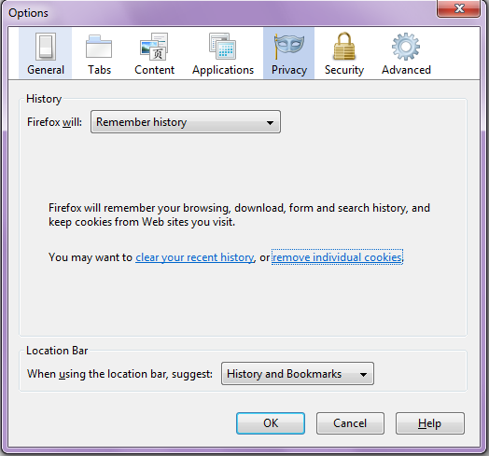
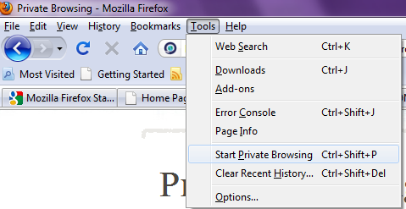
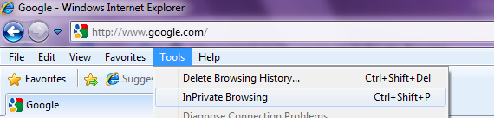
Looking for privacy…
ERASING COOKIES
PRIVATE BROWSING

Slide 33
Questions?
Thank you ☺

Slide 34
References
http://www.microsoft.com/protect/fraud/phishing/symptoms.aspx
Some of the examples were taken from:
http://antivirus.about.com/od/emailscams/ss/phishing.htm
http://www.utsa.edu/oit/images/MSC/phishing_example3.gif

Slide 35
http://www.sis.pitt.edu/~cybercard/lab/lab_page.htm

