Slide 1
Introduction to Security Lab Part 1
LERSAIS

Slide 2
Outline
Access Control in Unix
Access Control in Windows
Port Redirection

Slide 3
Access Control in Unix
Exercise

Slide 4
Unix File Security
Each file/directory has owner and group
How are the permissions set by a owner for
Read, write, execute
Owner, group, other ???
Only owner, root can change permissions
This privilege cannot be delegated or shared

Slide 5
Unix File Permissions
File type, owner, group, others
ls –l
drwx------ 2 jjoshi isfac 512 Aug 20 2003 risk management
lrwxrwxrwx 1 jjoshi isfac 15 Apr 7 09:11 risk_m->risk management
-rw-r--r-- 1 jjoshi isfac 1754 Mar 8 18:11 words05.ps
-r-sr-xr-x 1 root bin 9176 Apr 6 2002 /usr/bin/rs
-r-sr-sr-x 1 root sys 2196 Apr 6 2002 /usr/bin/passwd
File types
regular -, directory d, symlink l, device b/c, socket s, fifo f/p
Permissions
r, w, x
Any other permissions?

Slide 6
Permissions: Exercise
Do Part I: File Structure Setup
chgrp: change the group associated with a file
chown: change the owner of a file
Do Part II: Exercise File and Folder Permissions
chmod: change file system modes (permissions/special modes) of a file/directory
setuid | setgid | sticky | r | w | x | r | w | x | r | w | x
special |  |  | owner |  |  | group |  |  | others

Slide 7
umask
Specifies the permission you do not want given by default to new files
Bitwise AND with the bitwise complement of the umask value
Example
proposed permission: 0775 , umask: 0026
000 000 010 110 : 0026 umask
111 111 101 001 : 7751 complement of umask
˄000 111 111 101 : 0775 proposed permission
=000 111 101 001 : 0751 actual permission

Slide 8
umask: Exercise
Do Part III: Default File Permissions
What is the initial mask?
What are the permissions for testmask1?
What are the permissions for testmask2?
What about umask = 0000?
umask | User Access | Group Access | Other Access
0000 | All | All | All
0002 | All | All | Read, Execute
0007 | All | All | None
0022 | All | Read, Execute | Read, Execute
0027 | All | Read, Execute | None
0077 | All | None | None

Slide 9
Setid bits
Three setid bits
suid
set EUID of process to ID of file owner
sgid
set EGID of process to GID of file
suid/sgid used when a process executes a file
If suid(sgid) bit is on – the EUID (EGID) of the process changed to UID (GUID) of the file
Sticky
Off: if user has write permission on directory, can rename or remove files, even if not owner
On: only file owner, directory owner, and root can rename or remove file in the directory
What does this mean?
-r--r-sr-t 1 root user 12324 Mar 26 1995 /tmp/example

Slide 10
setuid: Exercise
Do Part IV: setuid bit, setgid bit and sticky bit
chmod 4755 /bin/touch
Why touch is denied second time?
setuid | setgid | sticky | r | w | x | r | w | x | r | w | x
special |  |  | owner |  |  | group |  |  | others

Slide 11
Access Control in Windows
Demo

Slide 12
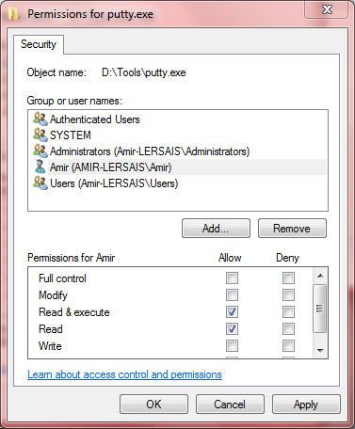
Permission Setting
Basic permission setting
Properties > Security > Edit
Add/remove users and groups
Define allowed/denied permissions
Advanced permissions?

Slide 13
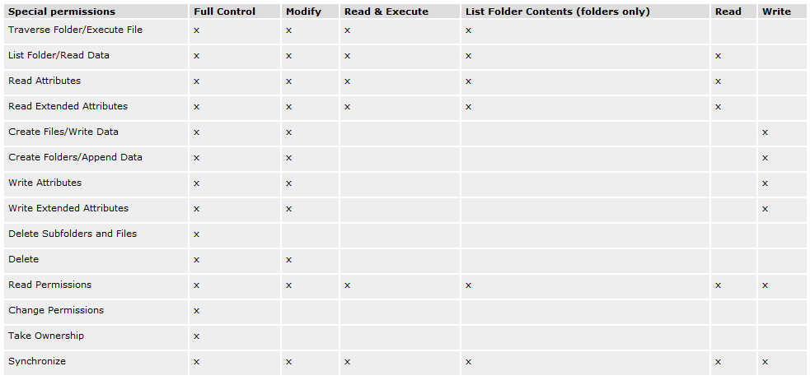
Permission Setting (cont.)
Advanced permissions

Slide 14
Access Control
Access control management in Unix vs. Windows
How different?
Which one is easier?
Which one is more efficient?

Slide 15
Port Redirection
Exercise

Slide 16
Port Redirection: The Threat
Exploit a machine and obtain access to a server with a filtered port by piping another unfiltered port
Trojans are hard to detect and can be used to mount such an attack

Slide 17
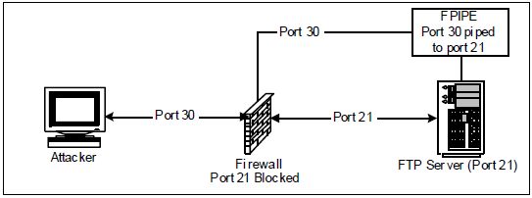
Exercise Scenario
An internally used FTP server
Information security department blocks certain known ports including 21, which is for FTP
A user logs into the server, and accidentally plants a trojan
The trojan enables port redirection on the FTP server
Attacker gains access to the FTP server via the redirected port!

Slide 18
Exercise
What security problems can occur due to port redirection?
What about useful purposes

