Slide 1
Program Development
With Python

Slide 2
Compiling
How does a program go from the code I write turn into binary that the computer can read?
x = 5
10110101001

Slide 3
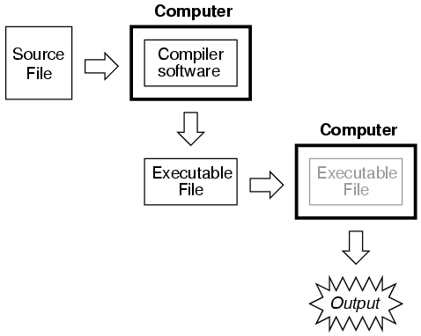
Compiling
Computers have a program called a compiler that has programming conventions stored in them.
The compiler knows
how to turn your code
into binary.
This is why syntax is
so important in
coding

Slide 4
Linking
Linking is a part of the compilation process that brings other programs into the compiled code
When you import a file (e.g. import sys) the linker goes at compilation and brings that file into the compiled code
Linking is especially important with library functions.

Slide 5
Library functions
Library functions are standard functions that come with Python.
Functions such as range() and print() are library functions because Python already knows what they are.

Slide 6
Programming Style
Style is very important in Python
Indentations are used to denote blocks of code as separate from each other
A # denotes a comment
Comments are lines in code
that are not compiled by the
compiler.
They are used for book-keeping
by the programmer

Slide 7
if Statements
if Statements are statements that evaluate a condition and act accordingly:
x = 3
if(x>2):
print(“Big)
else:
print(“Small”)
But do if statements have a more powerful component?

Slide 8
Nested If’s
Assigning grades:
How would you write a program that, given a numerical grade, prints the letter grade?
Nested if statements
allow you to evaluate
conditions inside of
a condition
This works exactly the
same as nested ifs in
excel.

Slide 9
Nested If’s
However, despite their usefulness, Nested if’s seem to be a sloppy way to do coding. They involve a lot of indents and can make code confusing to understand.
But how can we get around this?

Slide 10
Switch Statements
Here is the same program written using a switch statement:

Slide 11
Switch Statements
Unfortunately, Python doesn’t support switch statements.
Usually writing switch statements has some other workaround that the programmer hasn’t found, so if you think you need a switch statement, think harder!
if nothing comes to mind, nested if statements will do just find if you can figure out how to implement them.

Slide 12
else if
else if statements are another way to do switch statements without the massive indentations of nested if statements
else if statements allow
you to check a second case if
the first case fails.

Slide 13
While Loops
Loops are very important in programming. While loops are useful ways to avoid writing too many lines of code.
However, loops should be carefully implemented so as not to force an infinite loop.

Slide 14
For Loops
For loops are even more useful than While loops
For loops are good for counting things or for scrolling through an array one index at a time.

Slide 15
Where to begin:
First, import sys
Sys contains the basic system library files
You will probably end up using some of these functions in your programs
You also may need to import additional files depending on what you are doing
Initialize your variables
Variables should be initialized at the top of your program for cleaner bookkeeping
Normally, variables get initialized to 0 or None, depending on variable type

Slide 16
Writing a program
Next, you need to think about how you are going to approach the problem.
if you are asked to write a program that will compute number of buses to carry a number of students that the user will input

Slide 17
You will need:
Variable to hold number of students
Variable to hold number of buses
Variable to hold number of seats per bus

Slide 18
Obtain the input
Input function:
The input function returns the input of the user until the enter key is pressed
The input is passed a prompt for the user
int function will make the input into an integer

Slide 19
Compute the number of buses
Division seems like a good choice here:
But what happens if you have left over students?
(e.g. there are 20 seats per bus and 43 students)

Slide 20
Compute the number of buses
The division of 43/20 will give you 2.15
Since you can’t order 2.15 buses, you will need 3
Problem: When you convert 2.15 to an integer, it truncates the decimal:
Float 2.15 = Integer 2
What can you do?

Slide 21
Compute the number of buses
You need to add an extra bus if you have a decimal point.
How can you determine if you have a remainder after the division?

Slide 22
Modulus Operator
Python provides the programmer with a modulus operator
Modulus is represented by %
Modulus returns the remainder after an integer-division
e.g. 5%3 = 2
e.g. 7%6 = 1
e.g. 10%4 = 2
We can use modulus to solve this problem

Slide 23
Compute the number of buses
Here is what our computation would look like:

Slide 24
print the answer
The user needs to be given the answer as a form of output.
We can print this to the screen
Commas can be used to separate strings from non-strings

Slide 25
Writing a program

Slide 26
Debugging
What happens if I mistype something
e.g. I import syst instead of sys
Python tells us the line that caused the error

Slide 27
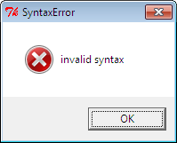
Debugging
What happens if I mistype a keyword like import?
I get a syntax
error

Slide 28
Debugging
For the most part, Python will tell you when you have done something wrong
if you are trying to type a keyword, and it doesn’t turn a different color, you have probably mistyped it
Otherwise, look at the line Python’s shell provides you with in the error and see if you can notice anything wrong.

Slide 29
Functions
All of Python’s inherent functions are located online at http://docs.python.org/3.1/library/

Slide 30
Common Mistakes
ofr i in range(5)
if (x<3)
while(x And y):
X is an array of length 5: print(x[5])
print(Hello World)
if(y=4)
d = float(7/4)
x = 3 + input(“Enter a number”)
x = int(7)

Slide 31
Common Mistakes
def function(x):
a = 3
return x+3
c = function(5)
b = a + c
print(b)

Slide 32
Common Mistakes
def function(x):
print(x)
y = function(4)
print(y)

Slide 33
Practice:
Write a program that asks the user for a number of hours and a pay rate and computes the total payment. Remember to account for overtime being over 40 hours at time and a half.
Write a program that will find the largest number in an array and print it out.
Write a program that will print pi to 5 digits of precision. (pi can be obtained with math.pi and you will need to import math)

Slide 34
Homework
Write a program that, given a speed (mph) and time traveled (h), will give you the distance traveled (mi).
Write a program that will compute the Fahrenheit temperature given a Celsius temperature. (Hint: F = (9/5)C + 32)
Make this program continue to ask for input until the user enters “-99”
Make a program that, given a state abbreviation, will print the name of the state. This should accept capital or lowercase letters.

