Slide 1
Genomics and Personalized Care
Leming Zhou, PhD
Assistant Professor
Department of Health Information Management
School of Health and Rehabilitation Sciences
University of Pittsburgh

Slide 2
Human Genome Project
1990 – 2003
Goals:
determine the sequences of the 3 billion chemical base pairs that make up human DNA
store this information in databases
improve tools for data analysis
identify all the approximately 20,000-25,000 genes in human DNA
transfer related technologies to the private sector
address the ethical, legal, and social issues (ELSI) that may arise from the project
http://www.ornl.gov/sci/techresources/Human_Genome/home.shtml

Slide 3
DNA Sequencing Technologies
DNA sequencing: The process of determining the order of the nucleotide bases along a DNA strand
Technologies:
Sanger method, (invented in 1977)
Used in the Human Genome Project
Slow, and expensive ($300m/genome)
Whole Genome Shotgun sequencing (1995-2000)
Break the genome into short pieces
Sequence all the pieces in parallel
Put all the pieces back together
Faster and cheaper (~$10m/genome)
Next generation sequencing technologies (2000s)
454 life science (~$2m/genome, 2008)
Much faster speed & lower cost (<$5k/genome,2009)
Third generation sequencing technologies (after 2009)
Nanopore, single molecule real time sequencing (around $100/genome?)

Slide 4
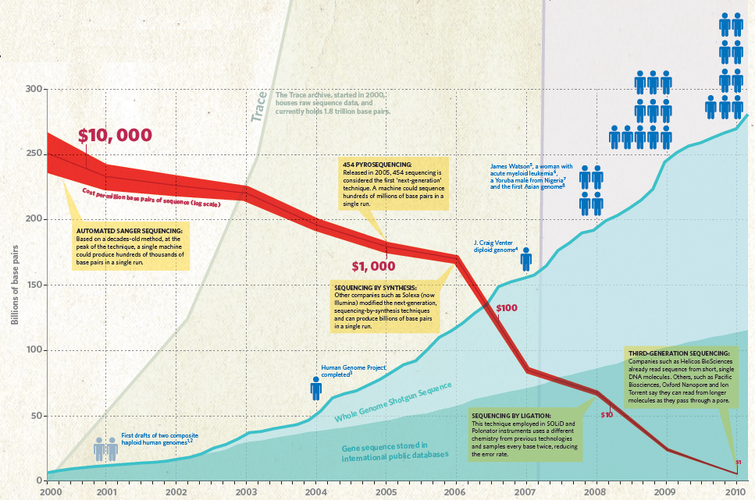
http://www.nature.com/news/2010/100331/full/464670a.html

Slide 5
Genetic Variations
Genetic variations make people different or cause disease
Eye color - common genetic variation
Down’s syndrome - rare genetic variation
Genetic variation is responsible for the adaptive changes that underlie evolution
Some changes improve the fitness of a species
Other changes are maladaptive. These maladaptive changes represent disease
Diversity of Diseases
Many regions of the genome may be affected
There are many mechanisms of mutation
Complex diseases: common disorders that have many causes
Alzheimer, diabetes, obesity, cancer, etc.

Slide 6
Genetic Variation, Environment, and Disease
Genes and gene products interact with their molecular environments
An individual interacts with the environment in ways that may promote disease or avoid disease
Example:
Lead poisoning is an environmental disease
Two children exposed to the same dose of lead may have entirely different responses.
This susceptibility has a genetic basis.
Genes affect susceptibility to environmental insults, and infectious disease.

Slide 7
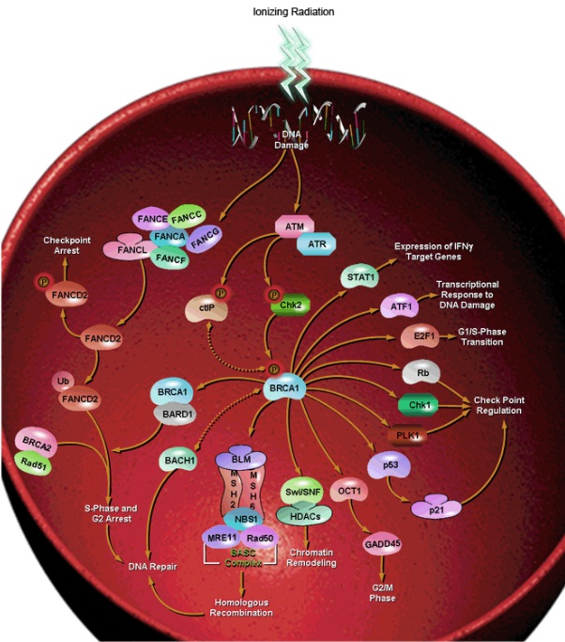
Biological Pathway
http://www.sabiosciences.com/

Slide 8
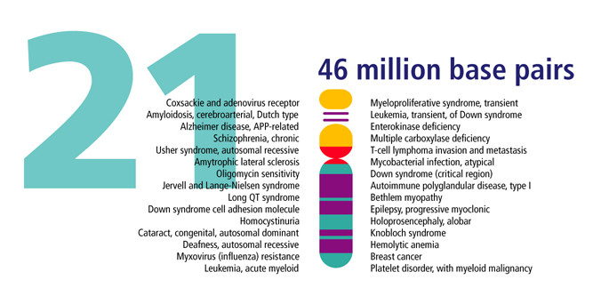
Genome Sequences and Diseases
http://genomics.energy.gov

Slide 9
Today’s Medical Practice
Three persons of the same height, weight, and age have the same symptom and go to a doctor. The doctor prescribes the same drug at the same dose (one-size-fits-all).
Person A has an adverse drug reaction
Person B nothing happens
Person C gets better
What do we do?
Person A: Reduce dose or change drug
Person B: Increase dose or change drug
Person C: Do nothing
Current drug development system develops drugs for the “average” patient
Results from large scale clinical trials
If a drug is effective on around 70% patients, it will be approved
How about the other 30% patients?
No simple way to determine who will respond well and who will respond poorly in the traditional way

Slide 10
Drugs have Different Effects on Patients
Example:
Aspirin
Effective to avoid thrombosis for some patients
Not effective for a number of patients
Reason:
A key must fit into the lock to open a door
Drugs (key) bind drug receptors (lock) on cells to cause effects
Genetic variation can cause variation in drug receptors and therefore different people have different drug responses

Slide 11
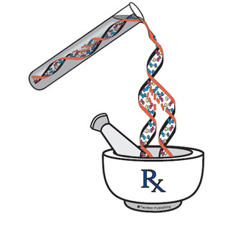
Pharmacogenomics
Pharmacogenomics is the study of how an individual's genetic inheritance affects the body's response to drugs.
Pharma = drug or medicine
Genomics = the study of gene
Personalized medicine tailored to your genes

Slide 12
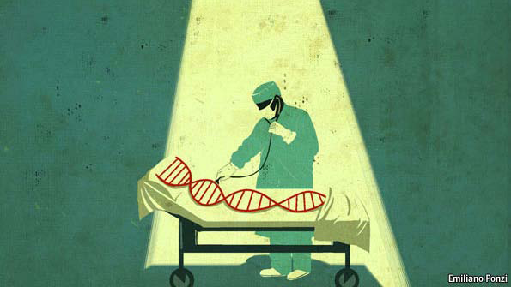
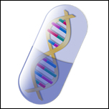
Future: Personalized Care
You feel terrible, and you go and see a doctor.
The physician looks you over, check you medical history, listens to your symptoms, take a look at your genome, and decides to prescribe you a drug specific for you (right drug and dose).
Personalized drug is more effective & minimizes side effects
http://www.economist.com/node/16349422/
http://www.prweb.com/releases/2005/12/prweb318956.htm

Slide 13
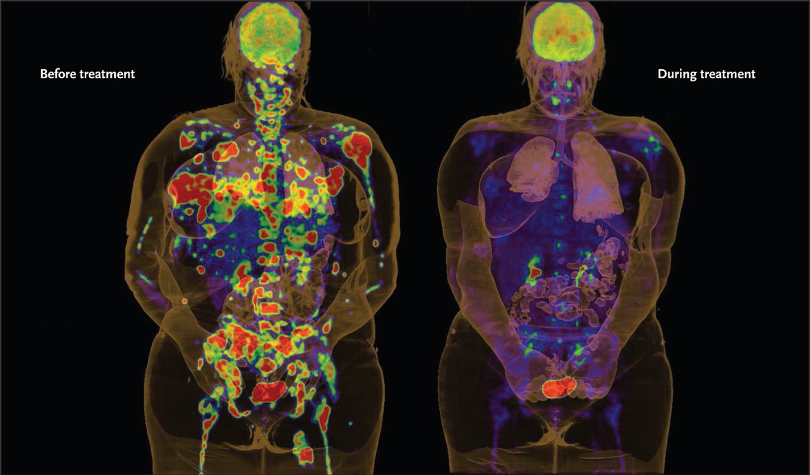
Treating Cancer with Personalized Drug
The two photographs below show the same individual before and after treatment with a molecule code-named PLX4032.
The shadows are tumors from secondary melanoma, one of the most aggressive cancers known.
PLX4032 cleared them almost completely. It was designed specifically to interact with the protein produced by a particular mutated version of a gene called B-RAF.
Treatment Day 0 Treatment Day 15
McDermott U et al. N Engl J Med 2011;364:340-350.

Slide 14
Personal Genomes: Benefits and Potential Risks
The availability of personal genomes will make true personalized medicine possible
Early detection of developing diseases
Preventive healthcare
Customized drug according to your gene makeup
More effective
Less side effects
Risks
One can be traced by his/her genome sequence
A company can easily scan your DNA sample and predict your susceptibility of having some serious diseases
Your genome is also highly related to your relatives genomes
……
Patient safety
Assuring informed consent
Protecting genetic information
Protecting patients from unjust discrimination
Social discrimination
Employment discrimination
Insurance discrimination

Slide 15
Genetic Info. Non-Discrimination Act
Specifically deals with genetic information
Bans insurance companies from denying health individuals coverage or charging higher premiums
Prevents employers from using genetic information of their employees

Slide 16
Medical Ethics
Nonmaleficence – doing no harm
Preventing unsolicited revelations concerning genetic info.
Benefcence – doing good
Achieved through the discovery of disease-related genes and improved treatments
Justice- treating everyone fairly
Avoiding genetic discrimination
Autonomy – respecting the individual’s right to self determination
Preserving your own genetic information
Utility – doing the most good and the least harm
Duty to warn

Slide 17
Discussion Questions
If someone finds they are genetically susceptible to heart disease would that knowledge change their behavior?
Should genetic tests be made available if there is currently no treatment for the disorder? If it is available, should the doctor let the patient know the positive result? Should the doctor let the family members of the patients know the positive result?
Should parents have the right to have their minor children tested for adult onset diseases?
Who should have access to stored genetic information? Who owns or controls it?
How can families resolve conflicts when some members want to be tested for a genetic disorder and others do not?
Should employers be able to require job applicants to take genetic tests as a condition of employment?
How would you feel if you tested positive for a genetic disorder? Will you share the information with your family member? How would you feel if you tested negative?

Slide 18
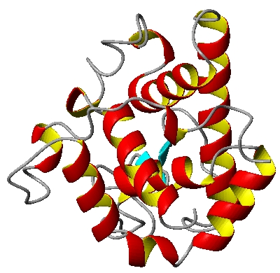
Reason of Introducing Genome Annotation
Obtain confidence in handling genomic data (DNA sequence)
Get familiar with tools for genomic data analysis
Build foundation for further study in the future
Gene and disease association, pharmocogenomics, ……
Typical human gene structure
Promoter region
Translation start
transcription factor
binding sites
TATA box
Gene
DNA coding strand
Sp1
C/EBP
Oct1
Initiator
Transcription
cap
Exon 1
Exon 2
AAUAAA
Intron
(A)n
primary transcript
5’ UTR
GT
AG
3’ UTR
Splicing
ATG
TGA
5’ UTR
3’ UTR
mRNA
Translation
protein
(peptide)

